Slide 1


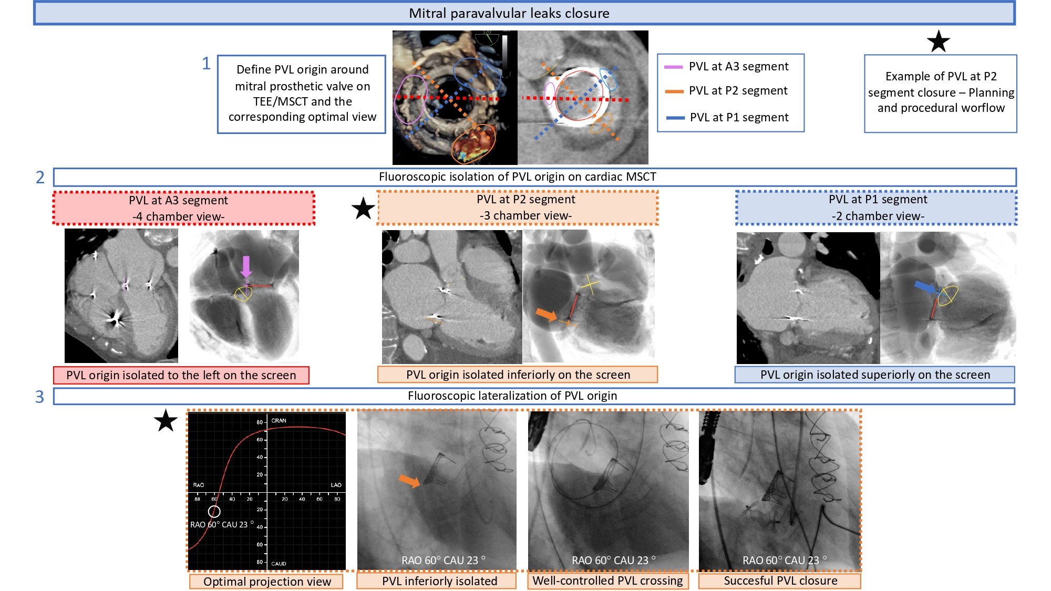

Echocardiographic, Fluoroscopic and CT guidance for transcatheter structural and coronary interventions
Figure 49
Optimal fluoroscopic view for mitral para valvular leak (PVL) plugging. Following localization using transesophageal echocardiographic (TEE) imaging, the PVL origin can be identified and labeled in the short-axis mitral annular plane viewed on cardiac multislice computed tomography. The optimal fluoroscopic projection for crossing and plugging can be determined by identifying a fluoroscopic view perpendicular to the PVL origin, thereby isolating (or lateralizing) the PVL origin. This figure illustrates 3 different PVL origins (at A3, P2 and P1 mitral valve segments), with their corresponding optimal fluoroscopic views. An example of a P2 segment PVL plugging which could be easily crossed and successfully closed using a fluoroscopic 3-chamber view is provided.
Horacio Medina de Chazal, Ali Zgheib, Angelo Quagliana, Michael Chetrit, Jean Buithieu, Giuseppe Martucci, Marco Spaziano, Ali Abualsaud, Ole de Baker, Laurence Campens, Pascal Theriault-Lauzier, Jeremy Ben-Shoshan, Nicolo Piazza
©2025 Europa Group - All rights reserved.

