Slide 1


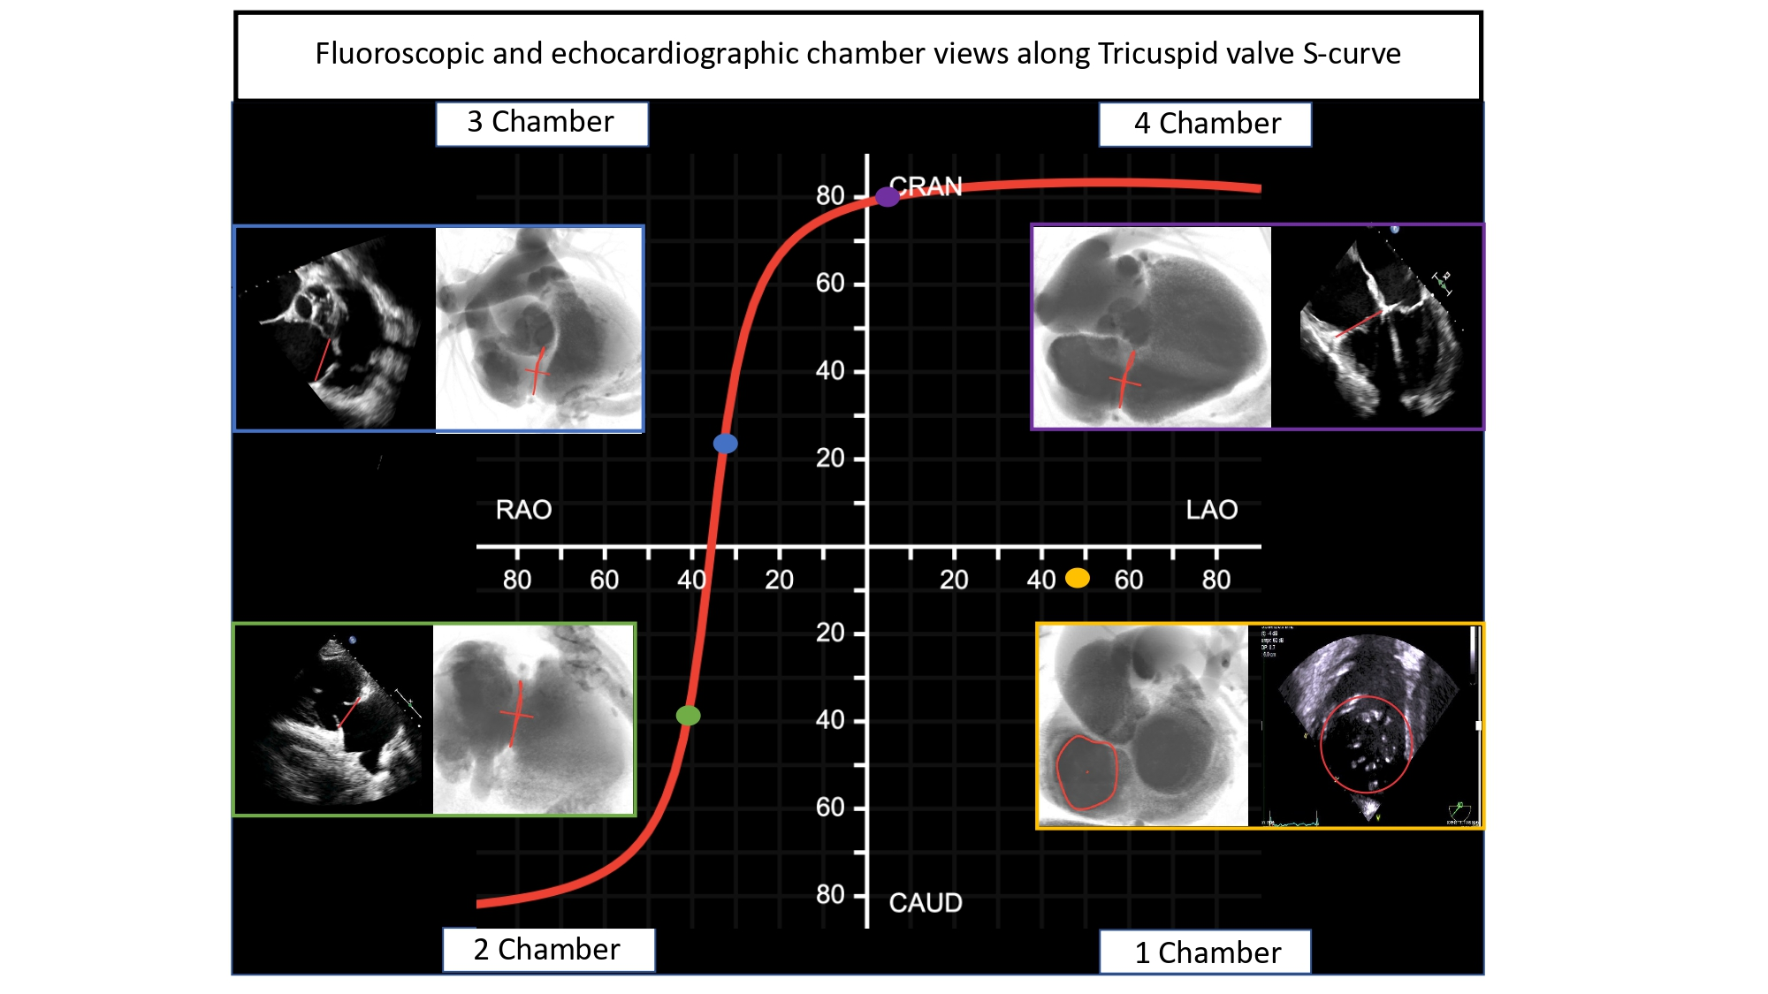

Echocardiographic, Fluoroscopic and CT guidance for transcatheter structural and coronary interventions
Figure 50
Tricuspid annulus S-curve. A typical tricuspid annulus S-curve travels across LAO CRA, shallow RAO CRA, and RAO CAU quadrants while the short-axis or en-face view is in steep LAO and shallow CAU angulation on the fluoroscopic grid. Chamber views emerge while transitioning across the mitral S-curve: a 4-chamber view is reached in the LAO CRA quadrants of the grid, a 3-chamber view is normally identified in shallow RAO CRA while an optimal 2-chamber is typically described in the RAO CAU quadrant. The 1-chamber or tricuspid valve short axis view is reached in LAO CAU. Fluoroscopic and TEE images are provided for each chamber view.
Horacio Medina de Chazal, Ali Zgheib, Angelo Quagliana, Michael Chetrit, Jean Buithieu, Giuseppe Martucci, Marco Spaziano, Ali Abualsaud, Ole de Baker, Laurence Campens, Pascal Theriault-Lauzier, Jeremy Ben-Shoshan, Nicolo Piazza
©2025 Europa Group - All rights reserved.

