Slide 1


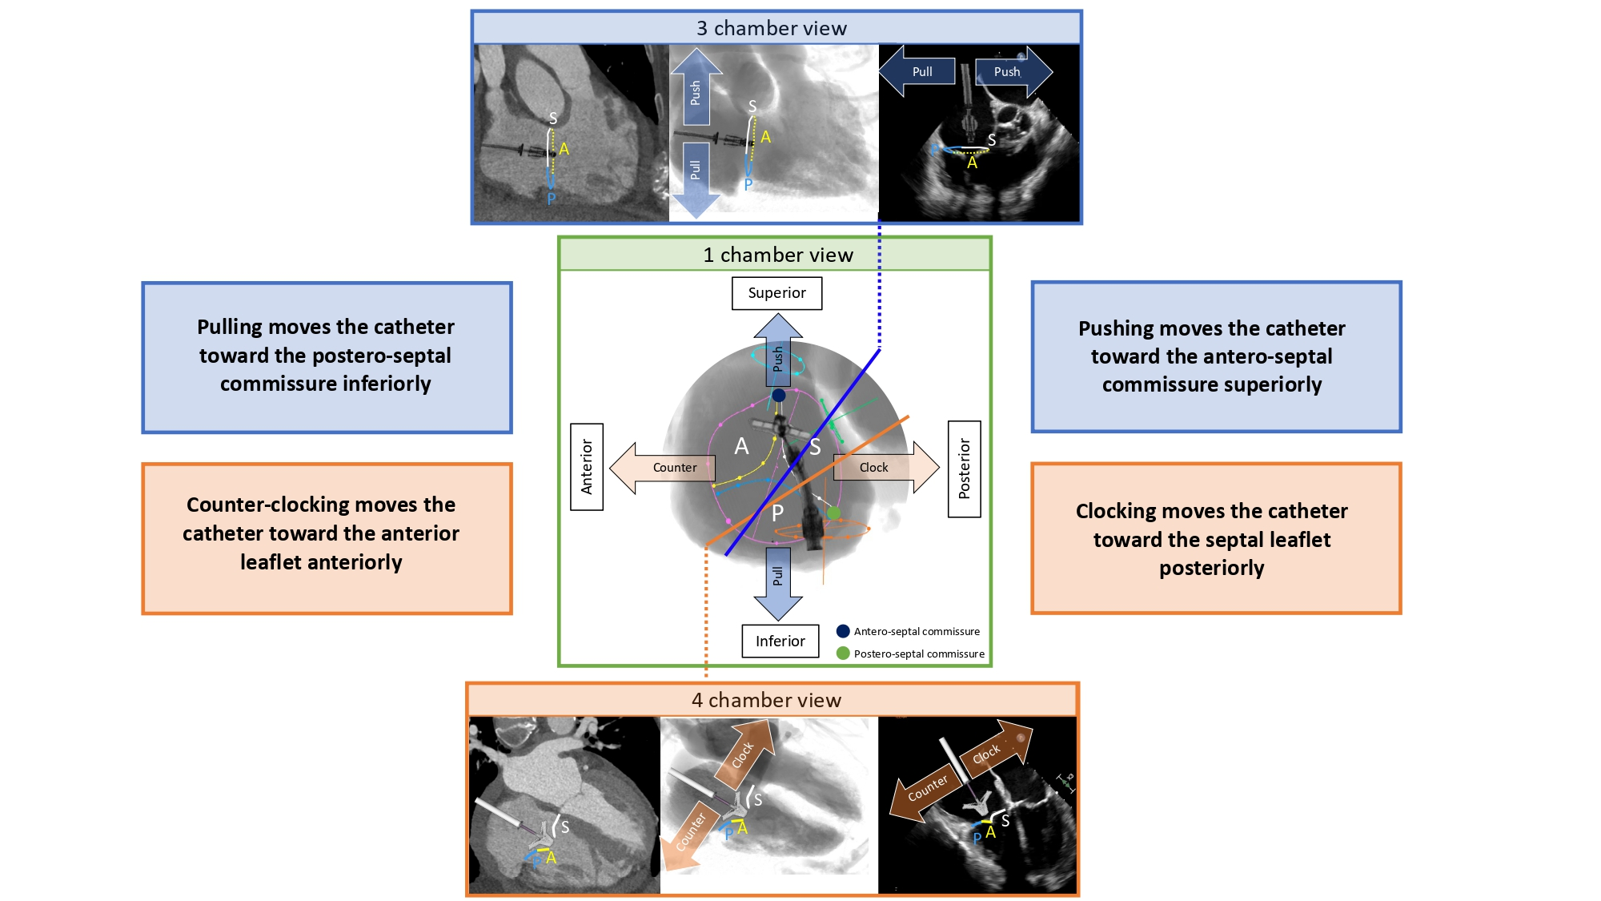
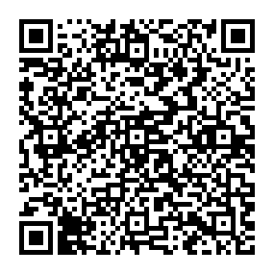
Echocardiographic, Fluoroscopic and CT guidance for
transcatheter structural and coronary interventions
Figure 51
Catheter manipulation for transcatheter tricuspid valve procedures across different chamber views.Green panel: 1-chamber fluoroscopic view, tricuspid annulus (pink circle), inferior vena cava (orange circle) and superior vena cava (turquoise circle), are simulated. Attitudinal orientation is indicated: superior (top), inferior (bottom), anterior (left), and posterior (right). Blue and orange lines indicate the 3-chamber and 4-chamber views, respectively. A clip catheter demonstrates movement in all three panels. Blue central panel: MDCT, fluoroscopy, and mid-esophageal TEE of the 3-chamber view. Orange central panel: MDCT, fluoroscopy, and mid-esophageal TEE of the 4-chamber view. In the three panels, the anterior leaflet is represented by a yellow line, the posterior leaflet by a blue line, and the septal leaflet by a white line. Catheter movements are indicated by orange arrows for clockwise and counterclockwise rotation, and blue arrows for push and pull actions. A= anterior leaflet; P= posterior leaflet; S= septal leaflet.
Horacio Medina de Chazal, Ali Zgheib, Angelo Quagliana, Michael Chetrit, Jean Buithieu, Giuseppe Martucci, Marco
Spaziano, Ali Abualsaud, Ole de Baker, Laurence Campens, Pascal Theriault-Lauzier, Jeremy Ben-Shoshan, Nicolo Piazza
©2025 Europa Group - All rights reserved.

