Slide 1


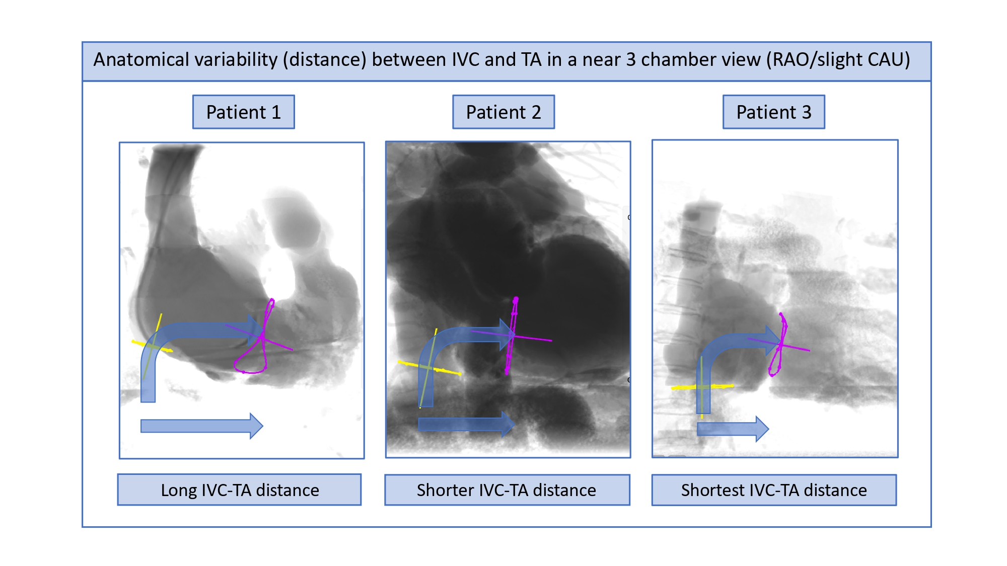

Echocardiographic, Fluoroscopic and CT guidance for
transcatheter structural and coronary interventions
Figure 53
Anatomical variability (distance) between IVC and TA in a near 3-chamber view (RAO/slight CAU) in patients 1, 2, and 3, depicted in blue panels. TA (pink circle) and IVC (yellow circle) are simulated. Curved blue arrow indicates the TA approach from the IVC. Straight blue arrow indicated the distance between the IVC and the TA. Distance variability between the IVC and TA can be observed between the 3 patients. A long distance IVC-TA distance is present in patient 1, whereas the shortest IVC-TA distance is observed in patient 3. TA= tricuspid annulus; IVC= inferior vena cava.
Horacio Medina de Chazal, Ali Zgheib, Angelo Quagliana, Michael Chetrit, Jean Buithieu, Giuseppe Martucci, Marco
Spaziano, Ali Abualsaud, Ole de Baker, Laurence Campens, Pascal Theriault-Lauzier, Jeremy Ben-Shoshan, Nicolo Piazza
©2025 Europa Group - All rights reserved.

