Slide 1


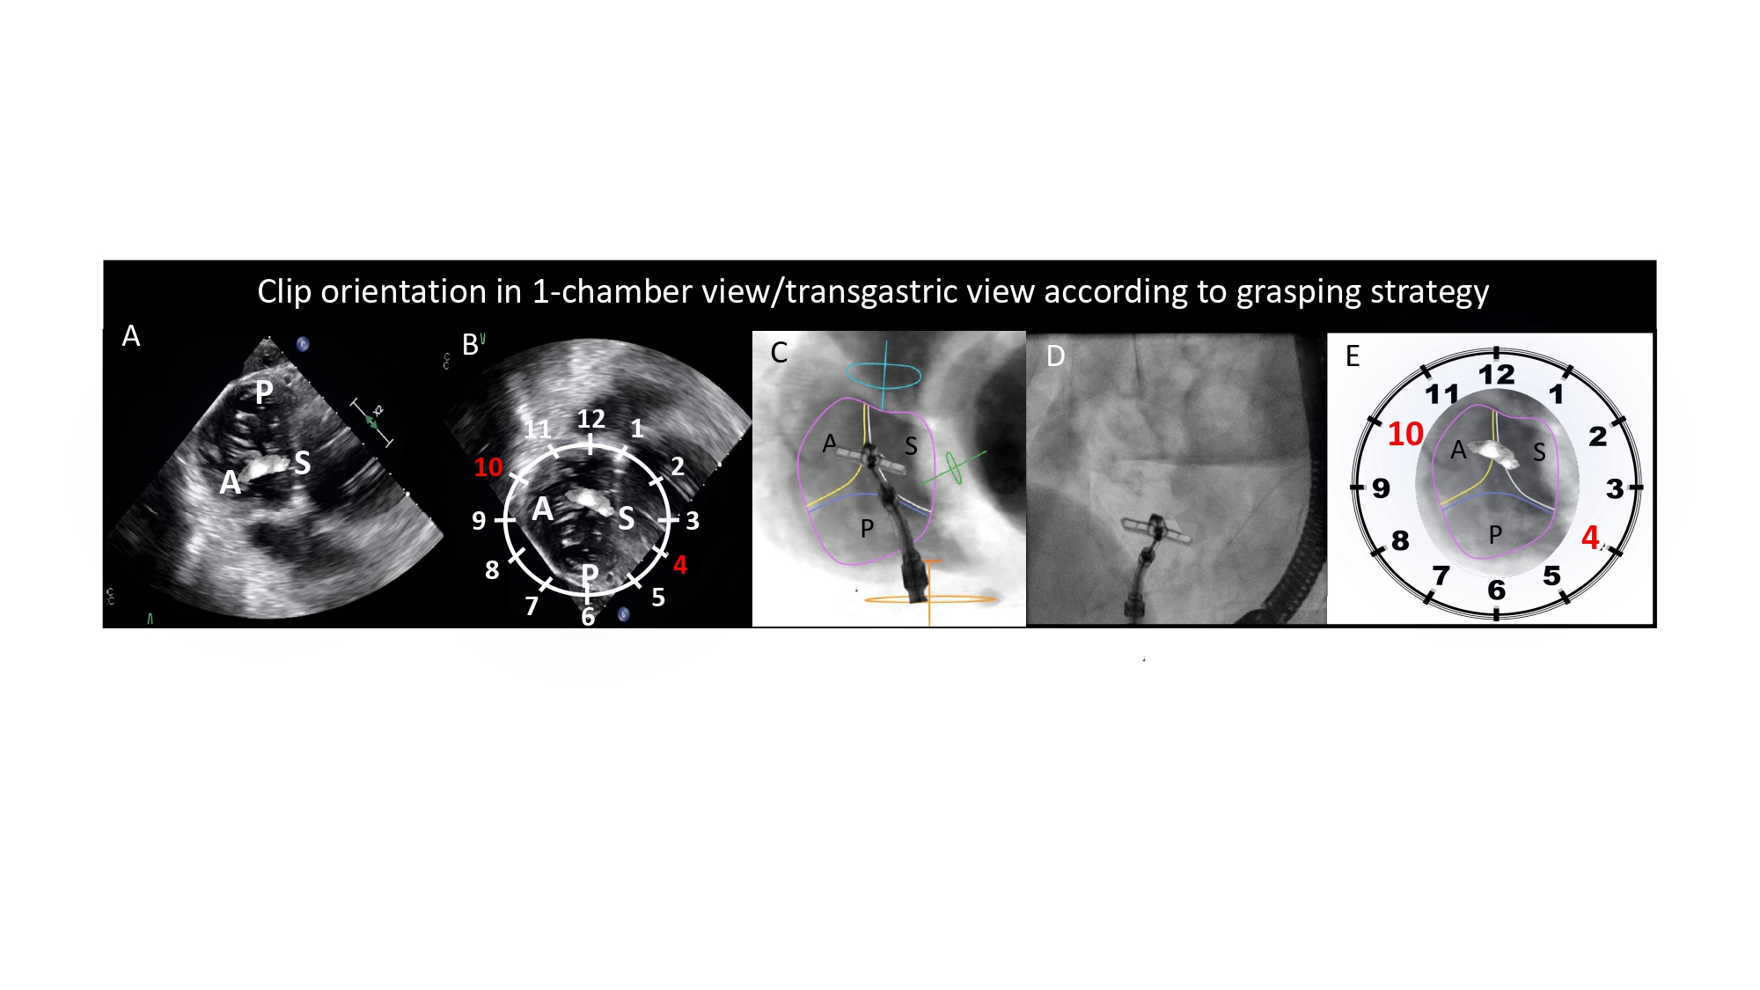
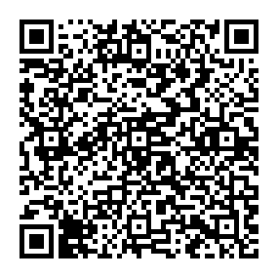
Echocardiographic, Fluoroscopic and CT guidance for transcatheter structural and coronary interventions
Figure 54
Clip orientation in 1-chamber view/transgastric view according to the grasping strategy. Tricuspid annulus (pink circle), anterior leaflet (yellow line), posterior leaflet (blue line), septal leaflet (white line), inferior vena cava (orange circle) and superior vena cava (turquoise circle), are simulated. The orientation of the clip arm can vary based on the selected grasping strategy and the specific anatomy of the tricuspid valve. This figure illustrates a septal-anterior grasping, in A) conventional transgastric TEE view, B) modified transgastric TEE view with an overlay of a 12-hour clock, C) simulated fluoroscopy, D) actual fluoroscopy and E) overlay of a 12-hour clock on the en-face view of the tricuspid valve. The clip arm is typically oriented between 4 and 10 o clock on the modified TEE transgastric view and fluoroscopic 1-chamber view in LAO CAU. A= anterior leaflet; P= posterior leaflet; S= septal leaflet.
Horacio Medina de Chazal, Ali Zgheib, Angelo Quagliana, Michael Chetrit, Jean Buithieu, Giuseppe Martucci, Marco Spaziano, Ali Abualsaud, Ole de Baker, Laurence Campens, Pascal Theriault-Lauzier, Jeremy Ben-Shoshan, Nicolo Piazza
©2025 Europa Group - All rights reserved.

