Slide 1


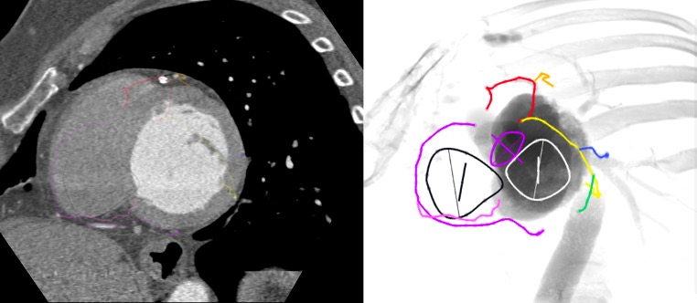

Echocardiographic, Fluoroscopic and CT guidance for transcatheter structural and coronary interventions
Figure 57
Coronary anatomy from a fluoroscopic one chamber view of the left heart (LAO CAU). In this view the RCA (purple) and circumflex (yellow) are seen elongated in its course along atrioventricular groove. The posterior descending artery is foreshortened. The LAD (red) is foreshortened within the interventricular groove.
Horacio Medina de Chazal, Ali Zgheib, Angelo Quagliana, Michael Chetrit, Jean Buithieu, Giuseppe Martucci, Marco Spaziano, Ali Abualsaud, Ole de Baker, Laurence Campens, Pascal Theriault-Lauzier, Jeremy Ben-Shoshan, Nicolo Piazza
©2025 Europa Group - All rights reserved.

