Slide 1


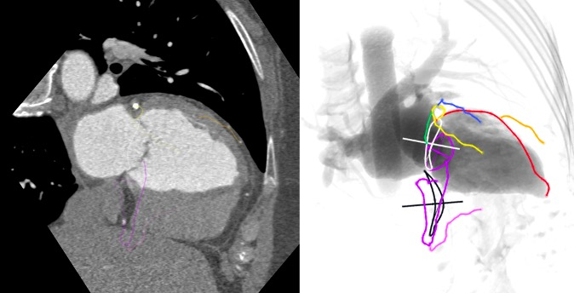

Echocardiographic, Fluoroscopic and CT guidance for transcatheter structural and coronary interventions
Figure 58
Coronary anatomy from a fluoroscopic two chamber view of the left heart (RAO CRA). In this view the LAD is seen fully elongated in its course along the anterior wall (red) and the circumflex artery is foreshortened within the atrioventricular groove (yellow-green). The mid-RCA (purple) can be also appreciated while the proximal and distal parts are foreshortened.
Horacio Medina de Chazal, Ali Zgheib, Angelo Quagliana, Michael Chetrit, Jean Buithieu, Giuseppe Martucci, Marco Spaziano, Ali Abualsaud, Ole de Baker, Laurence Campens, Pascal Theriault-Lauzier, Jeremy Ben-Shoshan, Nicolo Piazza
©2025 Europa Group - All rights reserved.

