Slide 1


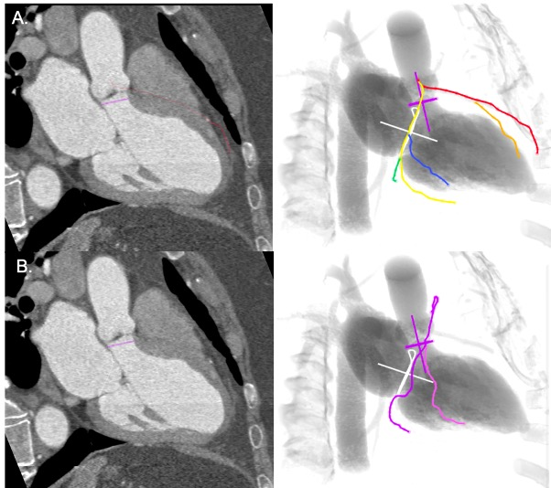

Echocardiographic, Fluoroscopic and CT guidance for
transcatheter structural and coronary interventions
Figure 59
Coronary anatomy from a fluoroscopic three chamber view (RAO CAU). On three-chamber view, the mitral and aortic valve are both in plane. Left system (A) - display the LAD artery (red) along the anteroseptal wall, well separated from the circumflex artery (yellow-green) which run an orthogonal course toward the inferolateral wall. Right system (B) - the mid RCA (purple) is fully elongated along the atrioventricular axis while the proximal and distal parts are foreshortened.
Horacio Medina de Chazal, Ali Zgheib, Angelo Quagliana, Michael Chetrit, Jean Buithieu, Giuseppe Martucci, Marco
Spaziano, Ali Abualsaud, Ole de Baker, Laurence Campens, Pascal Theriault-Lauzier, Jeremy Ben-Shoshan, Nicolo Piazza
©2025 Europa Group - All rights reserved.

