Slide 1


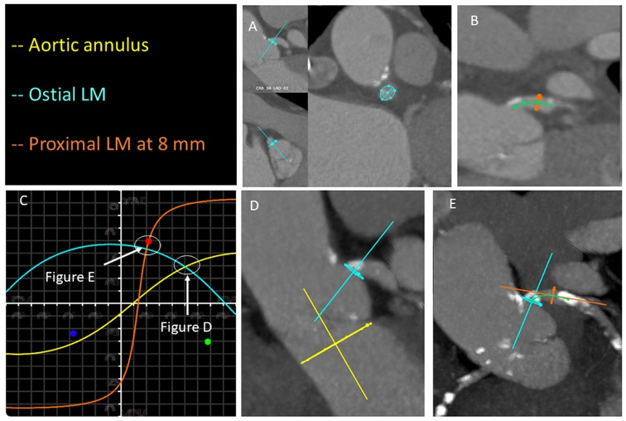

Echocardiographic, Fluoroscopic and CT guidance for transcatheter structural and coronary interventions
Figure 61
Analysis of optimal fluoroscopic viewing angles for ostial and proximal left main stenting. Ostium of the left main is identified in two orthogonal planes (A; turquoise closed spline). A centerline (green line) of the left main is created to identify the perpendicular plane of the proximal left main at 8 mm from the ostium (B). Optimal projection curves are then developed for the aortic annulus (yellow curve) and the ostial and proximal left main (turquoise and orange curves, respectively) (C). The fluoroscopic viewing angle obtained by the intersection between the aortic annulus and ostial left main optimal projection curves (D) mitigates parallax of the aortic root and allows a clear identification of the ostial left main. The fluoroscopic viewing angle obtained by the intersection between the ostial and proximal left main optimal projection curves (E) mitigates parallax of the proximal left main.
Horacio Medina de Chazal, Ali Zgheib, Angelo Quagliana, Michael Chetrit, Jean Buithieu, Giuseppe Martucci, Marco Spaziano, Ali Abualsaud, Ole de Baker, Laurence Campens, Pascal Theriault-Lauzier, Jeremy Ben-Shoshan, Nicolo Piazza
©2025 Europa Group - All rights reserved.

