Slide 1


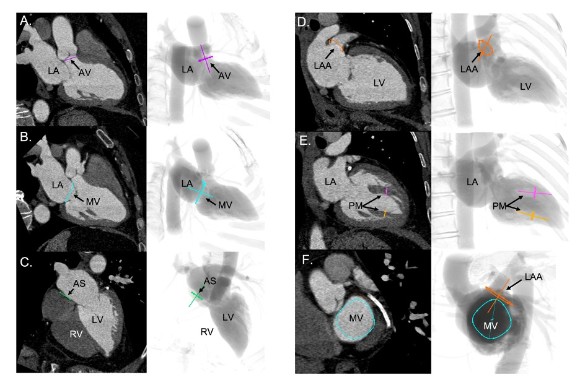

Echocardiographic, Fluoroscopic and CT guidance for transcatheter structural and coronary interventions
Figure 8
Fluoroscopic chamber views of the left heart. The region of fluoroscopic angulations corresponding to each of the chamber views of the left heart is shown. The mitral valve, aortic valve and atrial septum are traced in blue, yellow and green respectively. Average coordinates appear in Figure 5. CAU: caudal; CRA: cranial; LAO: left anterior oblique; RAO: right anterior oblique.
Horacio Medina de Chazal, Ali Zgheib, Angelo Quagliana, Michael Chetrit, Jean Buithieu, Giuseppe Martucci, Marco Spaziano, Ali Abualsaud, Ole de Baker, Laurence Campens, Pascal Theriault-Lauzier, Jeremy Ben-Shoshan, Nicolo Piazza
©2025 Europa Group - All rights reserved.

