Slide 1


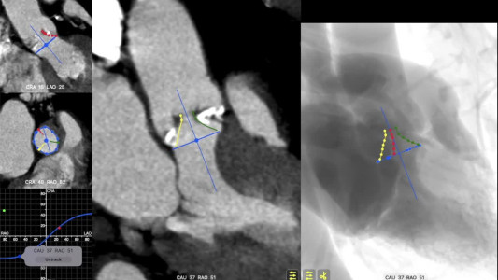
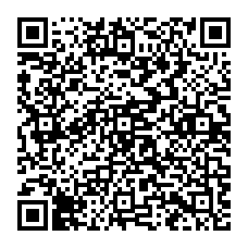
Echocardiographic, Fluoroscopic and CT guidance for transcatheter structural and coronary interventions
Video 1
The aortic annulus S-curve and cusp/commissural orientation. The orientation of the aortic valve cusps and commissures depends on the fluoroscopic projection used. This video shows the cusp and commissural orientation from six different fluoroscopic views along the aortic annulus S-curve. Fluoroscopic simulation is shown on the right of the screen. Left coronary cusp: red cusp and red line on fluoroscopic simulation; right coronary cusp: green cusp and green line on fluoroscopic simulation; non-coronary cusp: yellow cusp and yellow line on fluoroscopic simulation.
Horacio Medina de Chazal, Ali Zgheib, Angelo Quagliana, Michael Chetrit, Jean Buithieu, Giuseppe Martucci, Marco Spaziano, Ali Abualsaud, Ole de Baker, Laurence Campens, Pascal Theriault-Lauzier, Jeremy Ben-Shoshan, Nicolo Piazza
©2025 Europa Group - All rights reserved.

