Slide 1


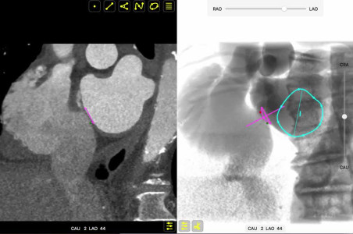

Echocardiographic, Fluoroscopic and CT guidance for transcatheter structural and coronary interventions
Video 3
Relation between transseptal puncture height and mitral valve height. The video shows the relation between transseptal puncture height (infero-superior aspect) with mitral valve height (antero-posterior aspect). The atrial septum (pink circle) and mitral valve (turquoise circle) are sequentially depicted in bicaval (LAO-CAU), and four chamber view (LAO-CRA). Despite two different appearing punctures on the bicaval view (i.e. superior and inferior punctures), the superior (red dot) and inferior (green dot) punctures from the four 4-chamber perspective translate into a same/nearly same height from the mitral valve plane.
Horacio Medina de Chazal, Ali Zgheib, Angelo Quagliana, Michael Chetrit, Jean Buithieu, Giuseppe Martucci, Marco Spaziano, Ali Abualsaud, Ole de Baker, Laurence Campens, Pascal Theriault-Lauzier, Jeremy Ben-Shoshan, Nicolo Piazza
©2025 Europa Group - All rights reserved.

