Slide 1


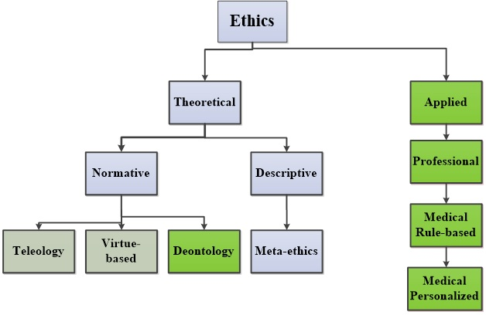

Ethics in cardiovascular interventions
Figure 1
Overview of normative and applied ethics’s categories. Categories of ethics based on nomenclature employed in philosophical literature (blue) and categories particularly relevant to medical ethics (green) are shown.
Peter Lanzer
©2025 Europa Group - All rights reserved.

