Slide 1


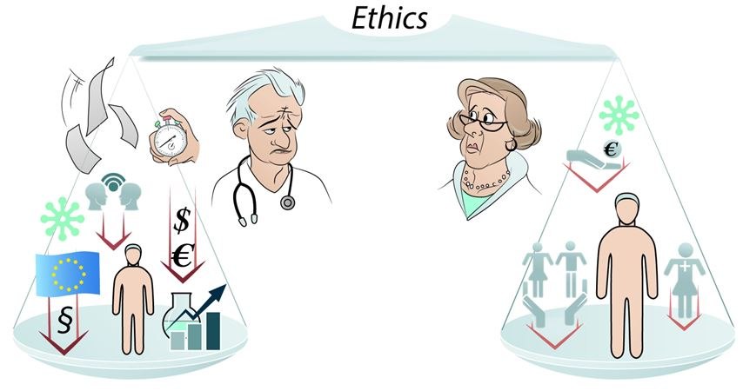

Ethics in cardiovascular interventions
Figure 2
Shown are the two perspectives within the physician-patient relationship. The perspective of the physician is characterized by increasing number of duties and obligations, partly not related or even possibly competing or conflicting with patient’s best interest, resulting in progressive lessening of patient’s central importance. The perspective of the patient is timeless determined by worries of one’s own health and preservation of economic welfare (Lanzer P. Eur Heart J 2022;43:1027-1028; with permission).
Peter Lanzer
©2025 Europa Group - All rights reserved.

