Slide 1


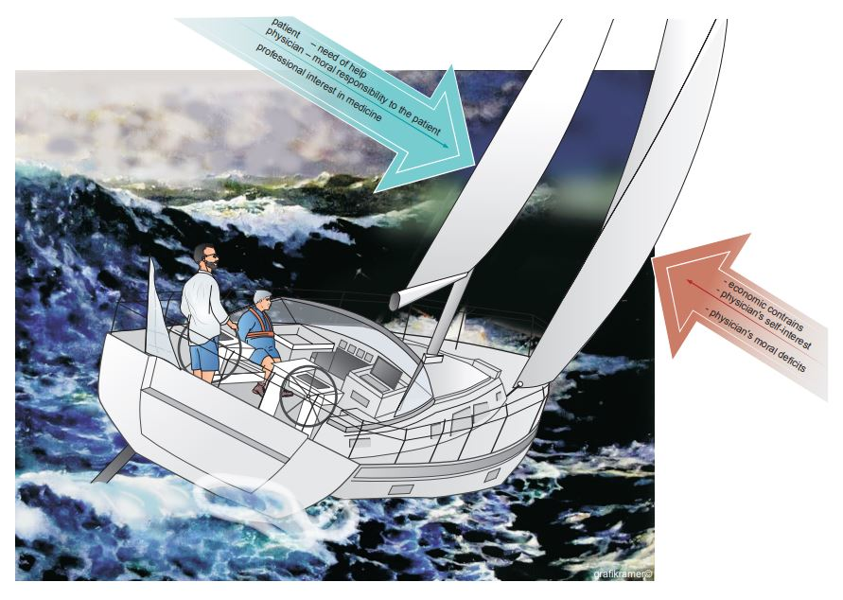

Ethics in cardiovascular interventions
Figure 3
Shown is physician-patient relationship exposed to external forces. Both physician and patient share the same boat. Their boat is driven by favourable (green) and adverse (red) forces, largely within the physician’s control. In addition, however, the boat is exposed to the stormy forces of global political, economic and environmental factors that are far beyond control of the physician and the patient.
Peter Lanzer
©2025 Europa Group - All rights reserved.

