Slide 1


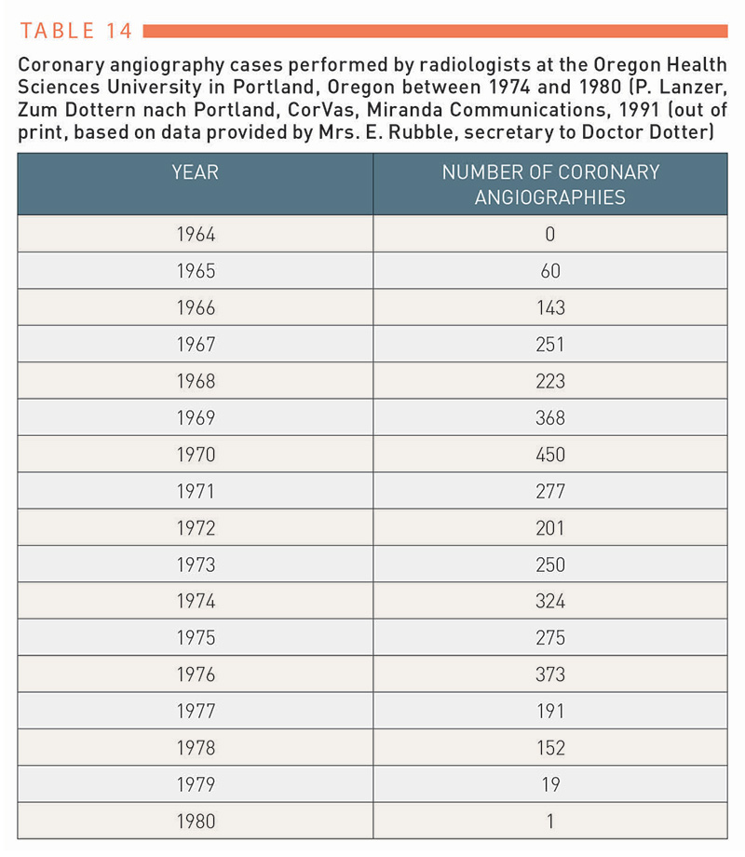

Ethics in cardiovascular interventions
Table 14
Peter Lanzer
©2025 Europa Group - All rights reserved.

