Slide 1


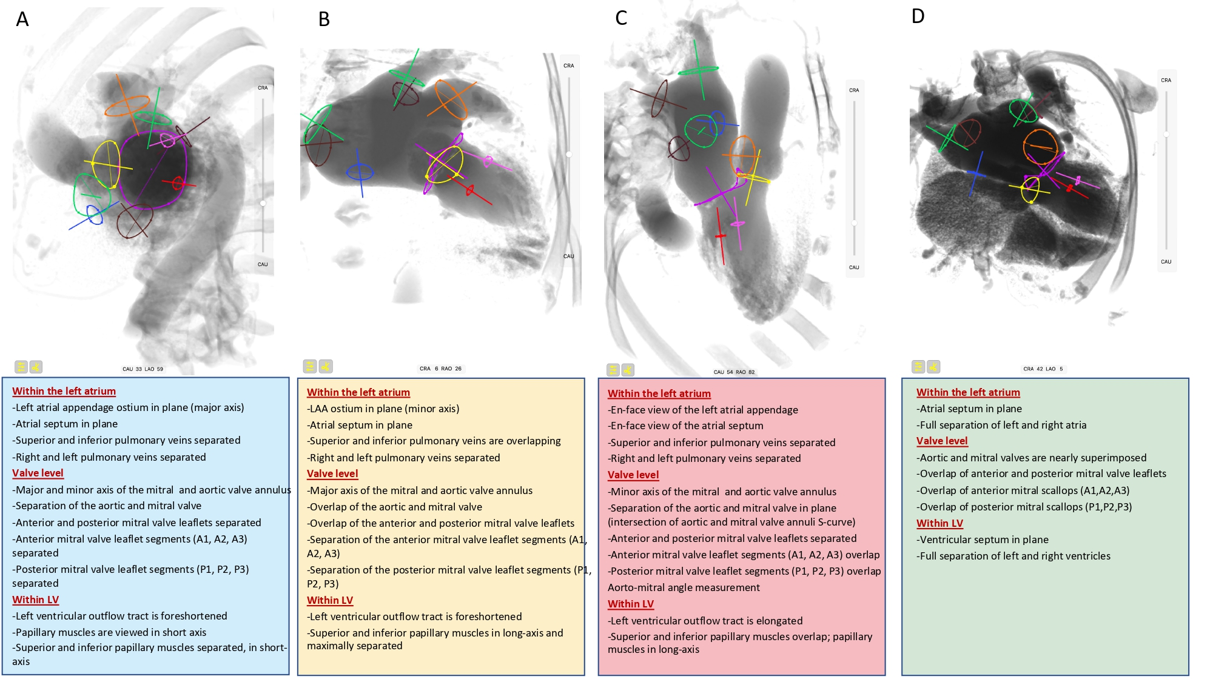

Fluoroscopic anatomy for the guidance of transcatheter structural and coronary intervention (old)
Figure 10
Fluoroscopic left sided cardiac structures in A (one chamber), B (two chamber), C (three chamber) and D (four chamber) view. The main cardiac structures are highlighted with circles, namely: superior pulmonary veins (green), inferior pulmonary veins (brown), left atrial appendage (orange), inter atrial septum (blue), aortic annulus (yellow), mitral annulus (violet), superior papillary muscle (pink), inferior papillary muscle (red).
Horacio Medina de Chazal, Ali Zgheib, Angelo Quagliana, Michael Chetrit, Jean Buithieu, Giuseppe Martucci, Marco Spaziano, Ali Abualsaud, Ole de Baker, Laurence Campens, Pascal Theriault-Lauzier, Jeremy Ben-Shoshan, Nicolo Piazza
©2025 Europa Group - All rights reserved.

