Slide 1


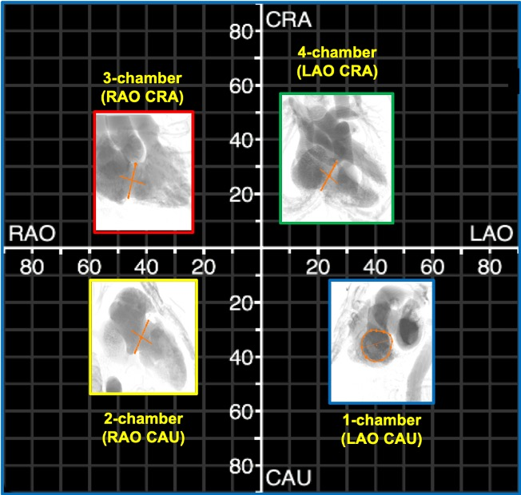

Fluoroscopic anatomy for the guidance of
transcatheter structural and coronary intervention (old)
Figure 12
Fluoroscopic chamber views of the right heart. The region of fluoroscopic angulations corresponding to each of the chamber views of the right heart is shown. The tricuspid valve is traced in orange. CAU: caudal; CRA: cranial; LAO: left anterior oblique; RAO: right anterior oblique.
Horacio Medina de Chazal, Ali Zgheib, Angelo Quagliana, Michael Chetrit, Jean Buithieu, Giuseppe Martucci, Marco
Spaziano, Ali Abualsaud, Ole de Baker, Laurence Campens, Pascal Theriault-Lauzier, Jeremy Ben-Shoshan, Nicolo Piazza
©2025 Europa Group - All rights reserved.

