Slide 1


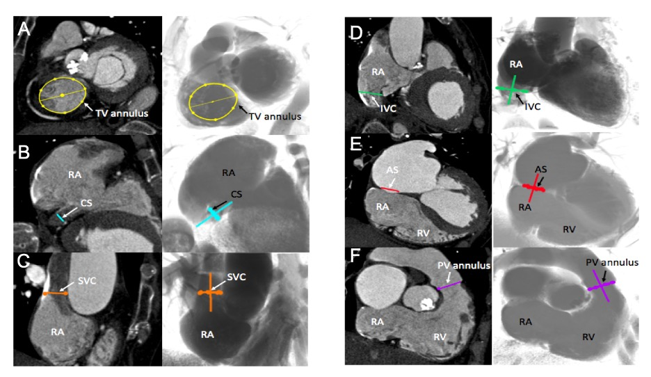
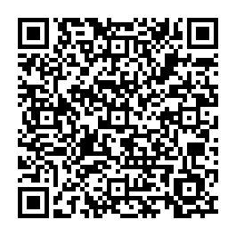
Fluoroscopic anatomy for the guidance of transcatheter structural and coronary intervention (old)
Figure 13
Multislice computed tomography chamber views of right-sided heart structures and corresponding fluoroscopy. A. TV=tricuspid valve, in yellow; B. CS=coronary sinus, in blue; C. SVC= superior vena cava, in orange; D. IVC=inferior vena cava, in green; E. AS=atrial septum, in red; F. PV=pulmonary valve, in purple. Structures are determined on MSCT (left column) and the simulated fluoroscopy (right column). RA=right atrium; RV=right ventricle.
Horacio Medina de Chazal, Ali Zgheib, Angelo Quagliana, Michael Chetrit, Jean Buithieu, Giuseppe Martucci, Marco Spaziano, Ali Abualsaud, Ole de Baker, Laurence Campens, Pascal Theriault-Lauzier, Jeremy Ben-Shoshan, Nicolo Piazza
©2025 Europa Group - All rights reserved.

