Slide 1


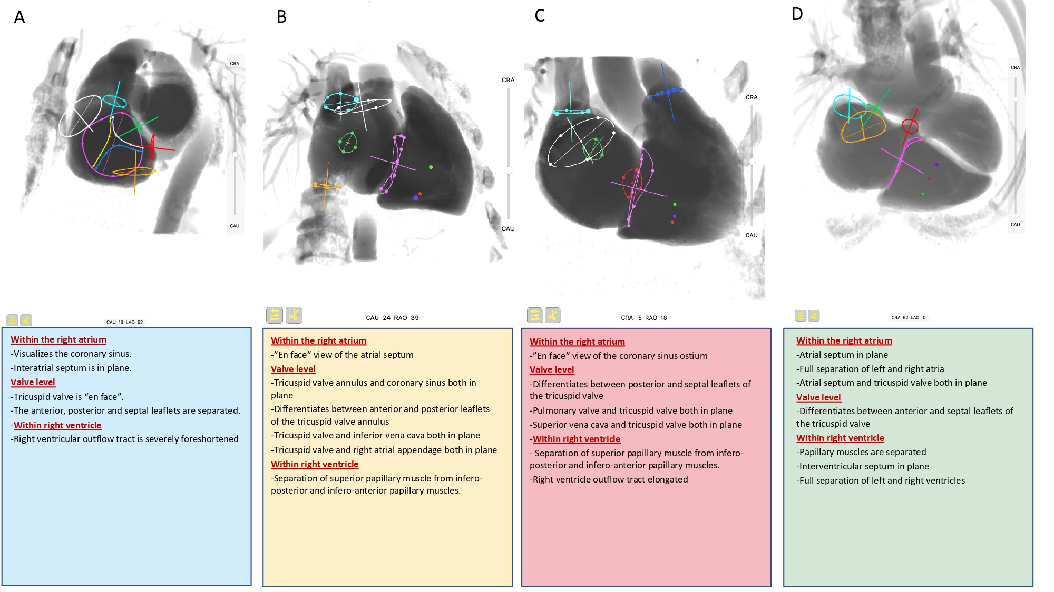

Fluoroscopic anatomy for the guidance of transcatheter structural and coronary intervention (old)
Figure 15
Fluoroscopic right sided cardiac structures in A (one chamber), B (two chamber), C (three chamber) and D (four chamber) view. The main cardiac structures are highlighted with circles, namely: tricuspid valve (violet), free edge of the anterior (yellow), septal (white) and posterior (blue) tricuspid valve leaflets, superior papillary muscle (green dot), inferoposterior papillary muscle (violet dot), inferoanterior papillary muscle (red dot), pulmonary valve (blue), inferior vena cava (orange), superior vena cava (turquoise), coronary sinus (red), and interatrial septum (green).
Horacio Medina de Chazal, Ali Zgheib, Angelo Quagliana, Michael Chetrit, Jean Buithieu, Giuseppe Martucci, Marco Spaziano, Ali Abualsaud, Ole de Baker, Laurence Campens, Pascal Theriault-Lauzier, Jeremy Ben-Shoshan, Nicolo Piazza
©2025 Europa Group - All rights reserved.

