Slide 1


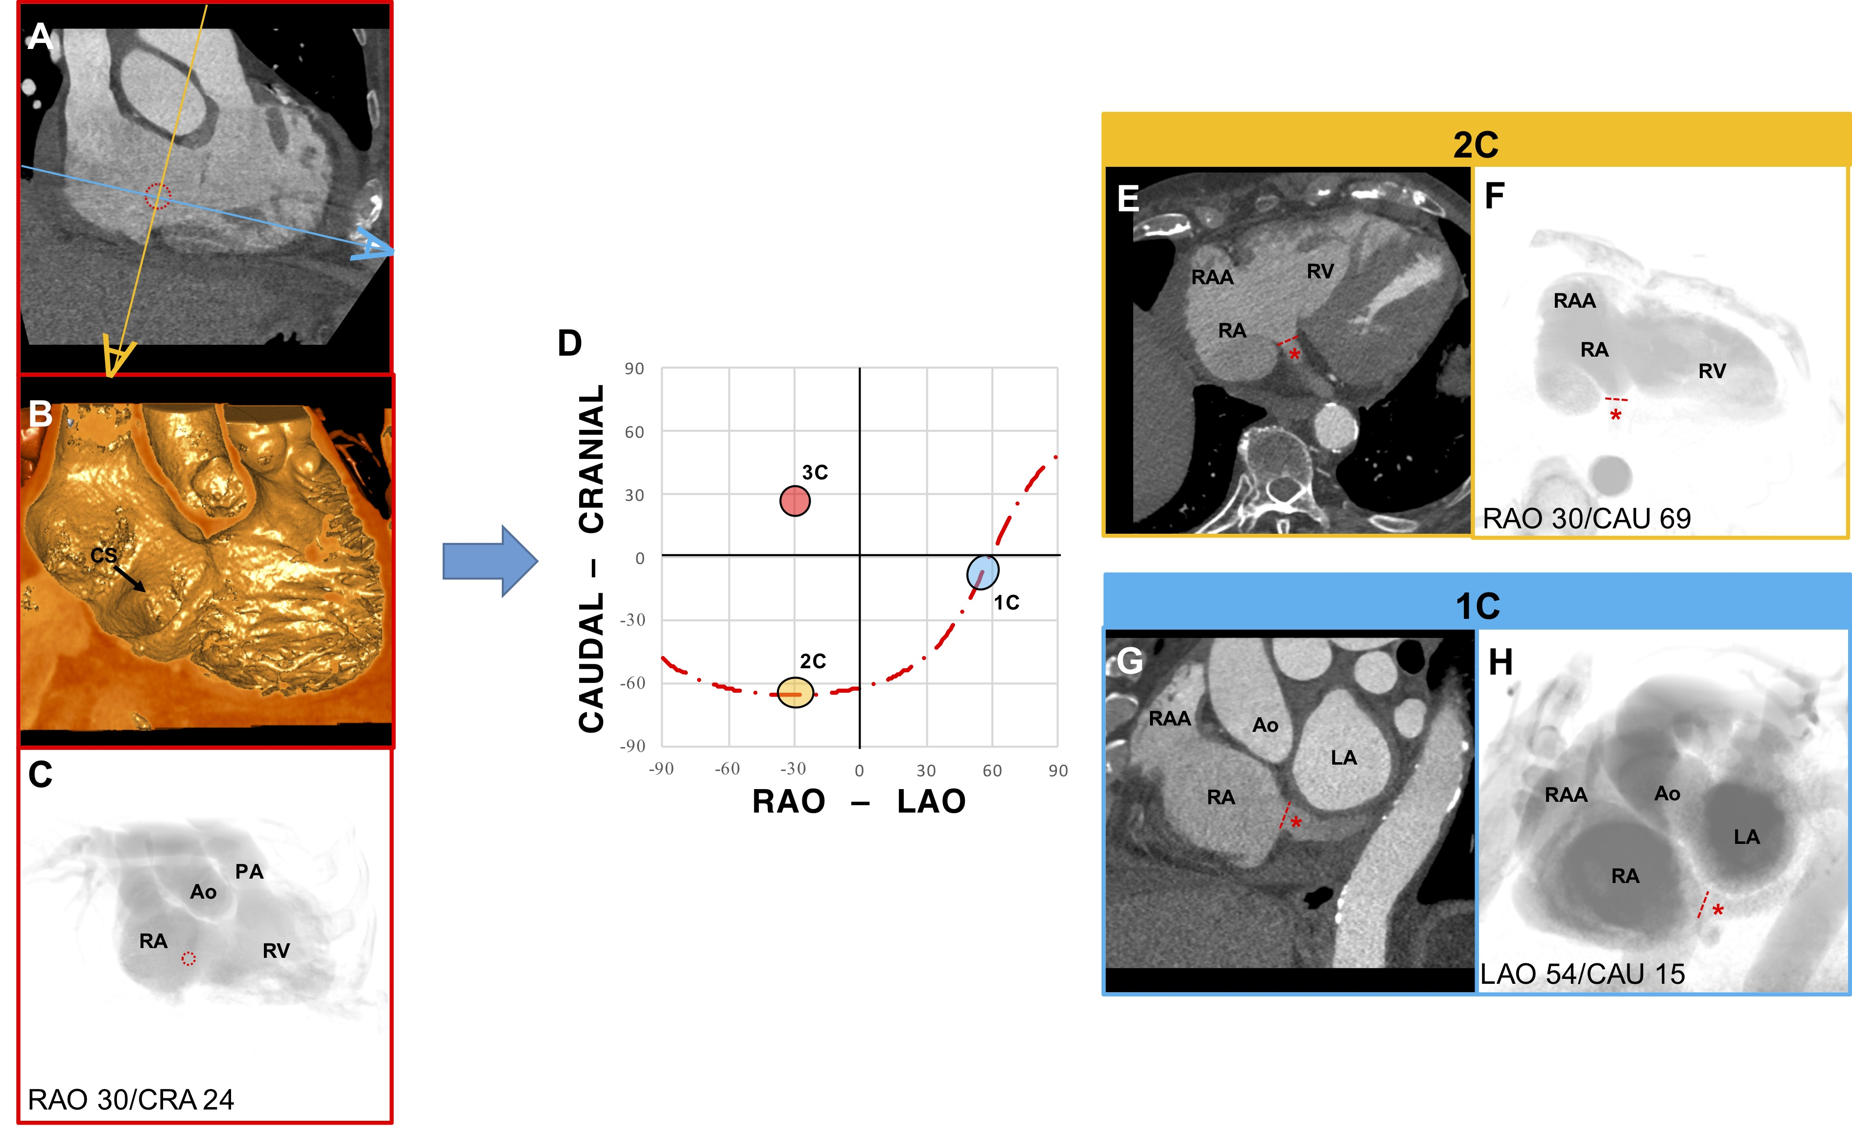

Fluoroscopic anatomy for the guidance of
transcatheter structural and coronary intervention (old)
Figure 17
Chamber view anatomy of the Coronary Sinus. (A) MSCT, (B) endovascular, and (C) fluoroscopic en face view of the coronary sinus (CS) (red dotted circle). (D) S-curve of the CS depicting the angulations of the 2-chamber (yellow), 3-chamber (red), and 1-chamber (blue) views. The 2 eye symbols describe the position of the x-ray detector in the corresponding fluoroscopic view; orange corresponds to E and F and blue to G and H. (E) The MSCT axial slice is in the same orientation of F, which shows the ostium of the CS (red dashed line) in plane. The distal course of the CS is shown by the red asterisk. (G) The MSCT sagittal slice is in the same orientation of H, which shows the ostium of the CS in plane and its course, in a short-axis view.
Horacio Medina de Chazal, Ali Zgheib, Angelo Quagliana, Michael Chetrit, Jean Buithieu, Giuseppe Martucci, Marco
Spaziano, Ali Abualsaud, Ole de Baker, Laurence Campens, Pascal Theriault-Lauzier, Jeremy Ben-Shoshan, Nicolo Piazza
©2025 Europa Group - All rights reserved.

