Slide 1


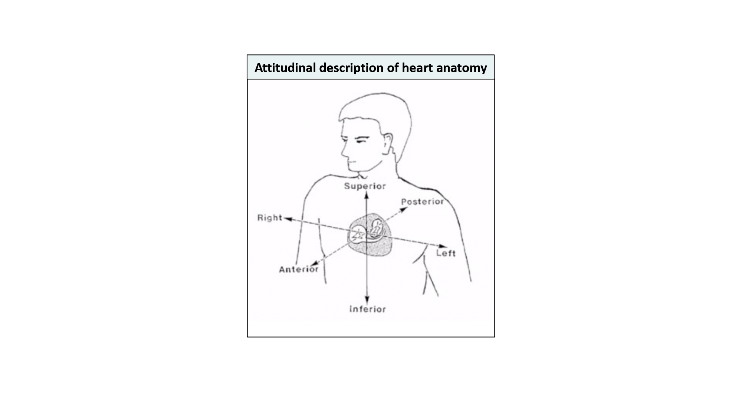

Fluoroscopic anatomy for the guidance of transcatheter structural and coronary intervention (old)
Figure 2
Attitudinal description of heart anatomy. structures should be termed according to their attitudinally correct anatomical position. structures closer to the observer are described as being anterior and those relatively farther away within the body are posterior. Components lying closer to the head are superior and those toward the feet are said to be inferior. Structures to the left-hand side of the observer are right-sided and those to the observer’s right are left-sided.
Horacio Medina de Chazal, Ali Zgheib, Angelo Quagliana, Michael Chetrit, Jean Buithieu, Giuseppe Martucci, Marco Spaziano, Ali Abualsaud, Ole de Baker, Laurence Campens, Pascal Theriault-Lauzier, Jeremy Ben-Shoshan, Nicolo Piazza
©2025 Europa Group - All rights reserved.

