Slide 1


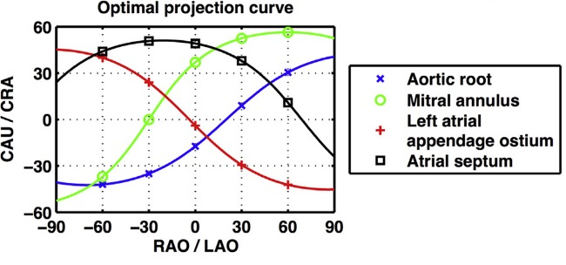

Fluoroscopic anatomy for the guidance of
transcatheter structural and coronary intervention (old)
Figure 20
Optimal projection curves. An optimal projection curve is a S-shaped curve consisting of continuous pairs of optimal CÃ¢â¬Âarm projections in which the structure appears in plane (i.e. perpendicular to the operator). Optimal projection S-curves varies between different structures depending on their spatial orientation. Intersection points of two S-curves represents C-arm coordinates in which the two structure are projected in plane.
Horacio Medina de Chazal, Ali Zgheib, Angelo Quagliana, Michael Chetrit, Jean Buithieu, Giuseppe Martucci, Marco
Spaziano, Ali Abualsaud, Ole de Baker, Laurence Campens, Pascal Theriault-Lauzier, Jeremy Ben-Shoshan, Nicolo Piazza
©2025 Europa Group - All rights reserved.

