Slide 1


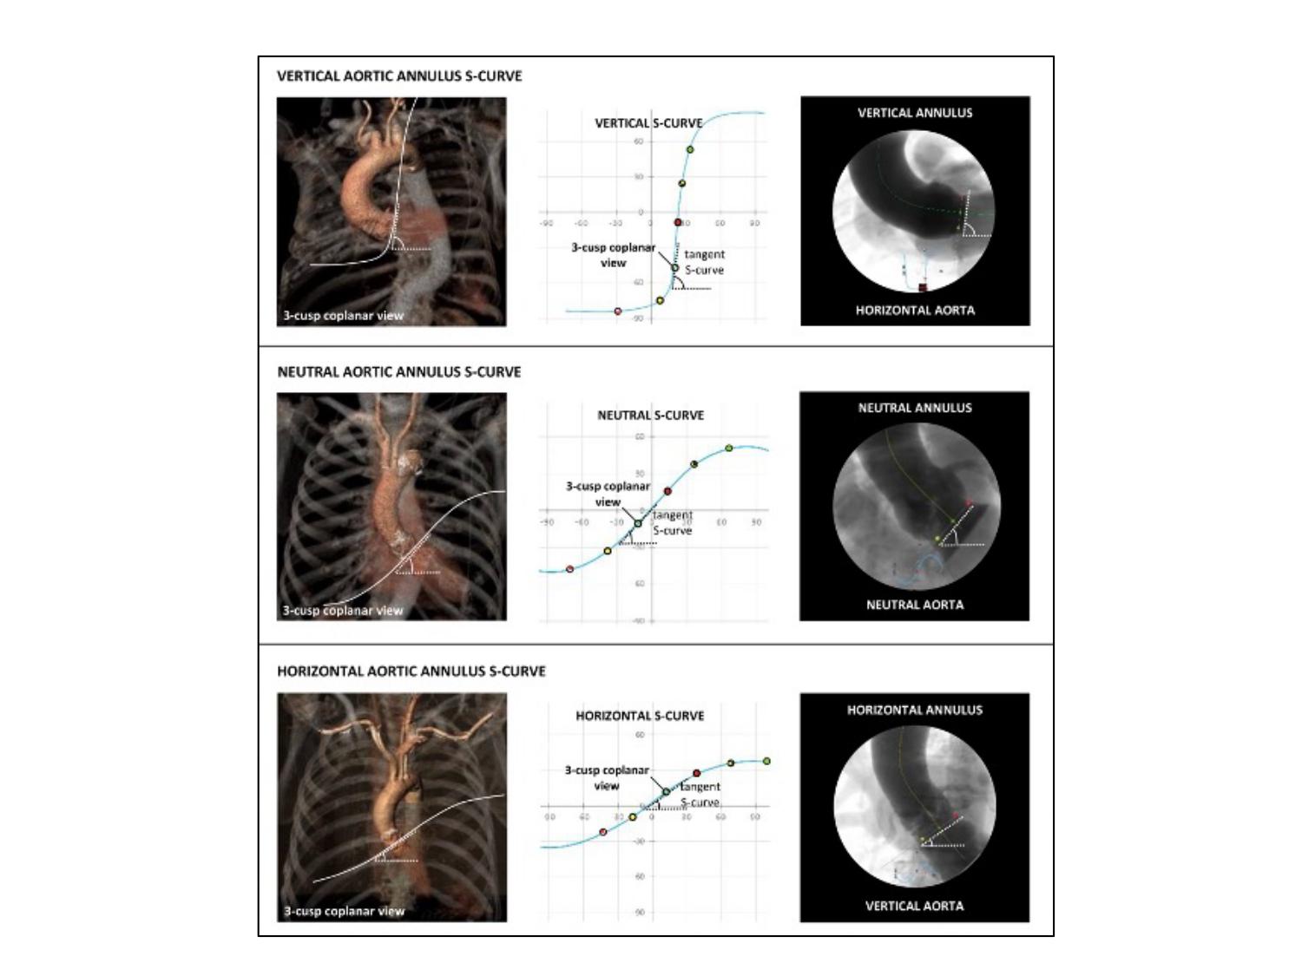

Fluoroscopic anatomy for the guidance of transcatheter structural and coronary intervention (old)
Figure 21
The slope of the S-curve represented by the aortic annulus. The shape and slope of a structure-specific S-curve is determined by the orientation of this particular structure in the body. A steep slope of the aortic annulus S-curve defines a vertical annulus plane, whereas a shallow slope defines a horizontal annulus plane. The middle scenario represents the most common situation where the S-curve has a more ‘neutral’ slope [12].
Horacio Medina de Chazal, Ali Zgheib, Angelo Quagliana, Michael Chetrit, Jean Buithieu, Giuseppe Martucci, Marco Spaziano, Ali Abualsaud, Ole de Baker, Laurence Campens, Pascal Theriault-Lauzier, Jeremy Ben-Shoshan, Nicolo Piazza
©2025 Europa Group - All rights reserved.

