Slide 1


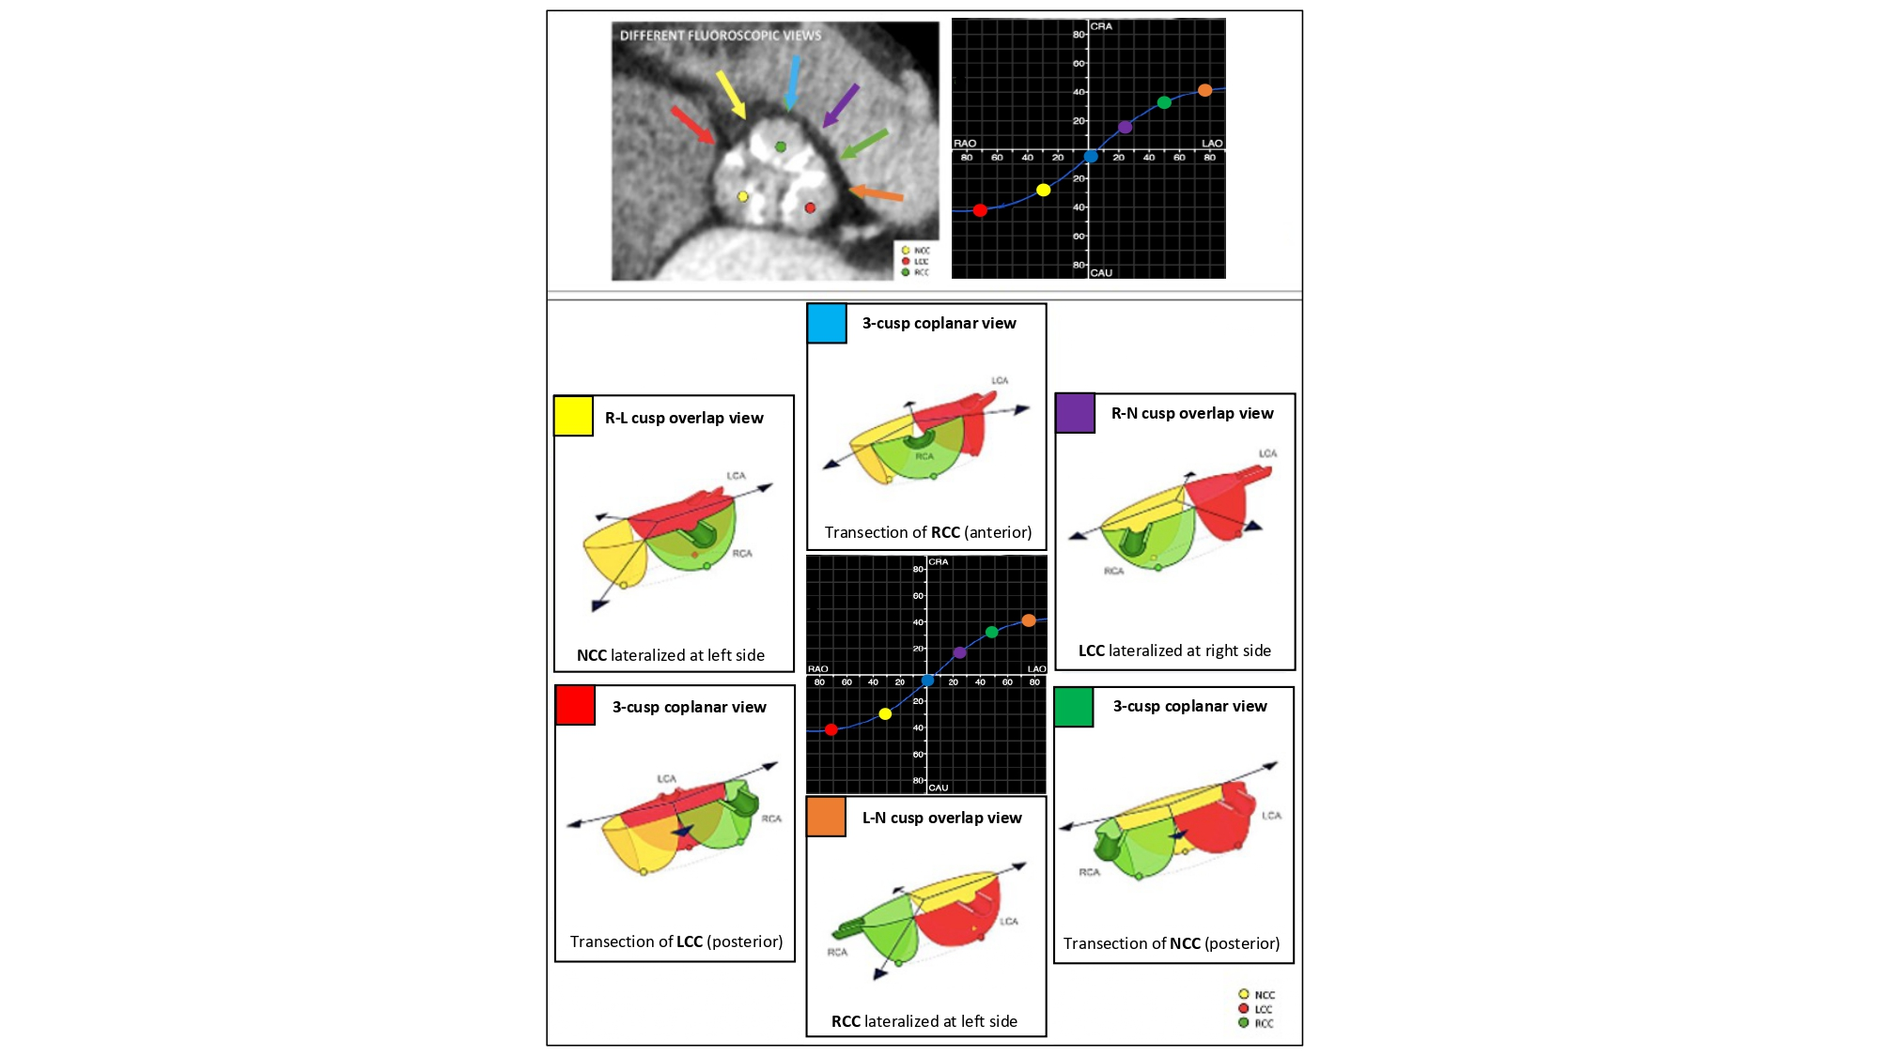

Fluoroscopic anatomy for the guidance of
transcatheter structural and coronary intervention (old)
Figure 22
The aortic annulus S-curve and cusp/commissural orientation. The orientation of the aortic valve cusps and commissures depends on the fluoroscopic projection used. This figure shows the cusp and commissural orientation from six different fluoroscopic views along the aortic annulus S-curve. The three most frequently used fluoroscopic projections are the R-L cusp overlap view (yellow), 3-cusp coplanar view (turquoise) and the R-N cusp overlap view (violet) – these projections also fall within easy reach of the table/patient, whereas the other projections are typically only reached by using more extreme C-arm angulations. LAO, left anterior oblique; LCC, left coronary cusp; NCC, non-coronary cusp; RAO, right anterior oblique; RCC, right coronary cusp [12].
Horacio Medina de Chazal, Ali Zgheib, Angelo Quagliana, Michael Chetrit, Jean Buithieu, Giuseppe Martucci, Marco
Spaziano, Ali Abualsaud, Ole de Baker, Laurence Campens, Pascal Theriault-Lauzier, Jeremy Ben-Shoshan, Nicolo Piazza
©2025 Europa Group - All rights reserved.

