Slide 1

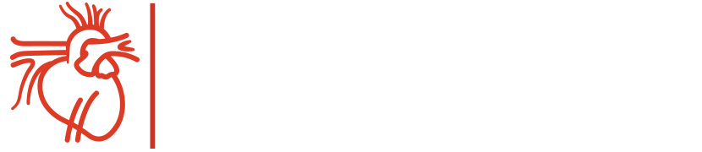
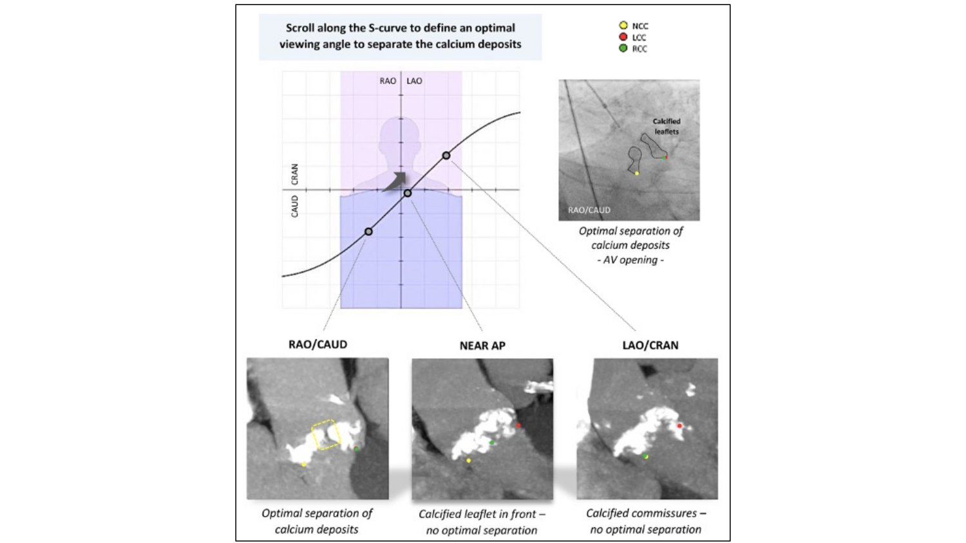

Fluoroscopic anatomy for the guidance of transcatheter structural and coronary intervention (old)
Figure 23
Fluoroscopic projections along the S-curve and AV Crossing. The optimal fluoroscopic projection along the S-curve for AV crossing is the angle where calcium deposits separate in systole (right upper panel). The left lower panel shows good separation of calcium deposits (yellow dotted square) in a RAO/CAU view (R-L cusp overlap view in this particular case, looking into the NCC-RCC and NCC-LCC commissures). In a near anteroposterior (AP) view (middle panel), the calcified RCC is positioned in front, which makes identification of the AV orifice difficult. In a LAO/CRAN view (right lower panel), calcium deposits at the level of the R-L commissure do not separate optimally in this particular case. AV, aortic valve; LAO, left anterior oblique; LCC, left coronary cusp; NCC, non-coronary cusp; RAO, right anterior oblique; RCC, right coronary cusp; CRA, cranial [12].
Horacio Medina de Chazal, Ali Zgheib, Angelo Quagliana, Michael Chetrit, Jean Buithieu, Giuseppe Martucci, Marco Spaziano, Ali Abualsaud, Ole de Baker, Laurence Campens, Pascal Theriault-Lauzier, Jeremy Ben-Shoshan, Nicolo Piazza
©2025 Europa Group - All rights reserved.

