Slide 1


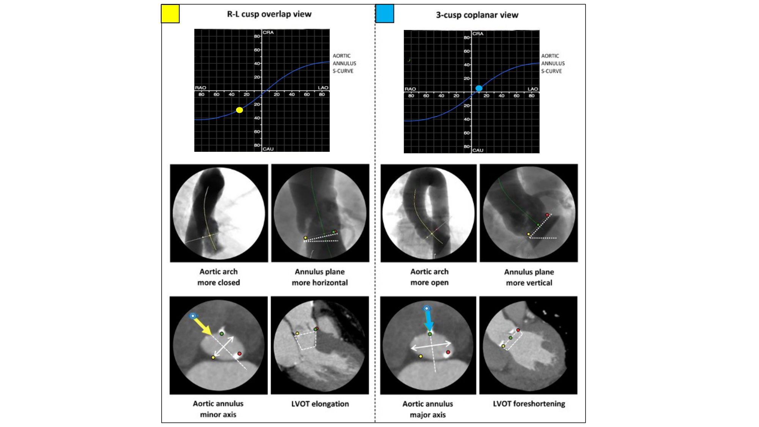

Fluoroscopic anatomy for the guidance of
transcatheter structural and coronary intervention (old)
Figure 24
Impact of implantation view on perception of aortic arch, aortic annulus and LVOT. The aortic arch is typically more closed and the aortic annulus plane more horizontal in an R-L cusp overlap view (compared with a 3-cusp coplanar view). Working in an R-L cusp overlap view also typically shows the minor axis of the aortic annulus (translating into a 3-chamber view) and elongation of the LVOT, whereas a 3-cusp coplanar projection shows the major axis of the aortic annulus (translating into a 2-chamber view) and foreshortening of the LVOT (white rectangle). LAO, left anterior oblique; RAO, right anterior oblique; CRA, cranial; CAU, caudal; LVOT, left ventricle outflow tract [12].
Horacio Medina de Chazal, Ali Zgheib, Angelo Quagliana, Michael Chetrit, Jean Buithieu, Giuseppe Martucci, Marco
Spaziano, Ali Abualsaud, Ole de Baker, Laurence Campens, Pascal Theriault-Lauzier, Jeremy Ben-Shoshan, Nicolo Piazza
©2025 Europa Group - All rights reserved.

