Slide 1


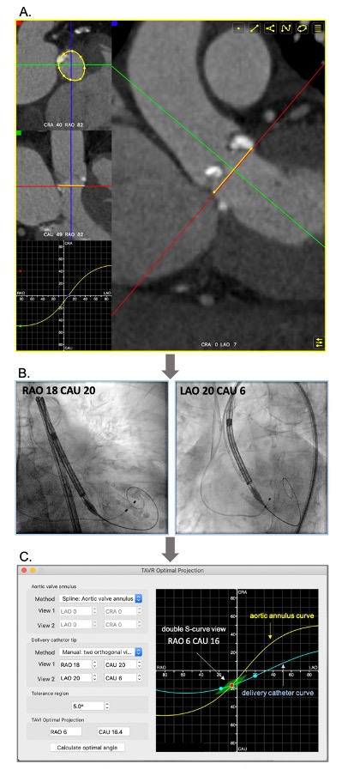
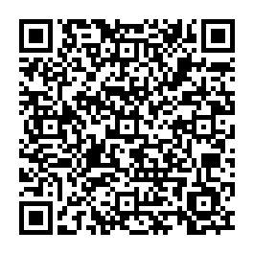
Fluoroscopic anatomy for the guidance of
transcatheter structural and coronary intervention (old)
Figure 25
The “double S-curve” model for definition of optimal projection for TAVI. Step 1 (A) - The S-curve of the aortic valve annulus, representing the perpendicular views of the annular plan, is generated (FluoroCT software 1.1.1). Step 2 (B) - Two random projections (e.g. RAO and LAO) of the delivery catheter marker in plane (without parallax) are obtained during the procedure. Step 3 (C) - The two fluoroscopic coordinates are formulated to generate the S-curve of delivery catheter using the FluoroCT software 1.1.1. The coordinates of intersection between the two S-curves (red dot) are then defined as the optimal projection for implantation with a pre-set deviation “tolerance” of ~5% (green deltoid).
Horacio Medina de Chazal, Ali Zgheib, Angelo Quagliana, Michael Chetrit, Jean Buithieu, Giuseppe Martucci, Marco
Spaziano, Ali Abualsaud, Ole de Baker, Laurence Campens, Pascal Theriault-Lauzier, Jeremy Ben-Shoshan, Nicolo Piazza
©2025 Europa Group - All rights reserved.

