Slide 1


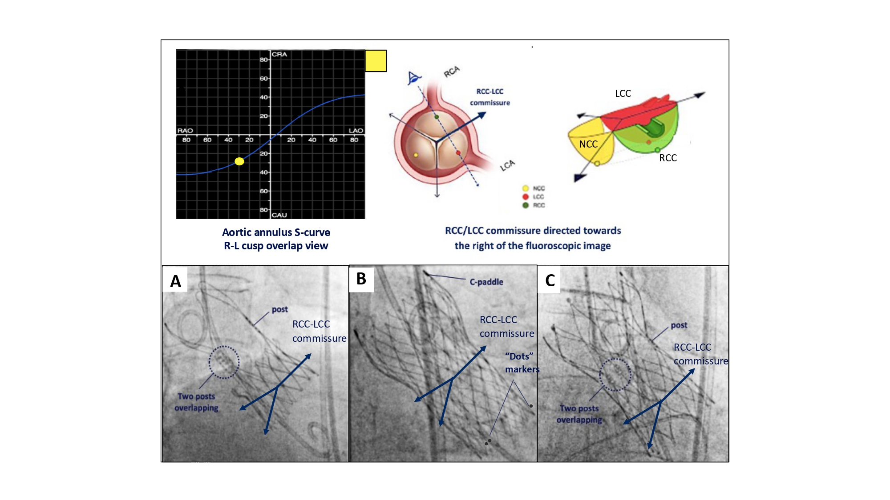

Fluoroscopic anatomy for the guidance of transcatheter structural and coronary intervention (old)
Figure 27
Implantation technique for obtaining patient-specific commissural Alignment. To obtain patient-specific commissural alignment during transcatheter aortic valve replacement, one can make use of the R-L cusp overlap view, in which the commissure between both cusps will be isolated and directed toward the right on fluoroscopy. Consequently, patient-specific commissural alignment will be obtained as follow: A) ACURATE Neo2 and C) Navitor: if one of the THV commissural posts can be lateralized at the right-hand side (with the 2 other THV commissural posts overlapping at the left-hand side in the R-L cusp overlap view). B) EVOLUT FX: one of the “dots marker” is lateralized at the right-hand side with the other two dots overlapping/nearly overlapping at the left-hand side of the screen [12].
Horacio Medina de Chazal, Ali Zgheib, Angelo Quagliana, Michael Chetrit, Jean Buithieu, Giuseppe Martucci, Marco Spaziano, Ali Abualsaud, Ole de Baker, Laurence Campens, Pascal Theriault-Lauzier, Jeremy Ben-Shoshan, Nicolo Piazza
©2025 Europa Group - All rights reserved.

