Slide 1


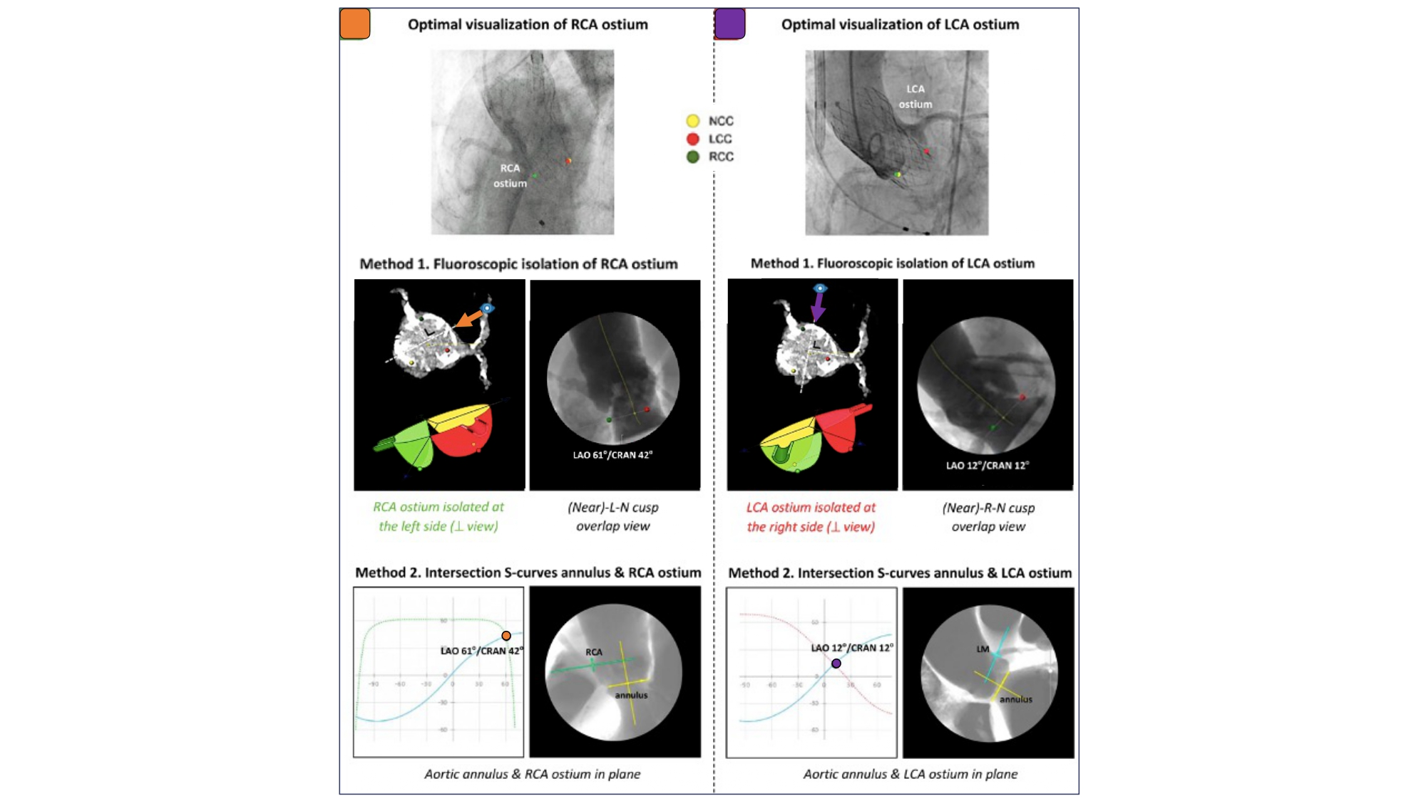

Fluoroscopic anatomy for the guidance of transcatheter structural and coronary intervention (old)
Figure 28
Optimal Fluoroscopic Views to Expose the Coronary Ostia/Coronary Access. The first method is based on fluoroscopic isolation of the right and left coronary ostia, projecting the RCA ostium at the left-hand side and the LCA ostium at the right-hand side, respectively. In the second method, one determines the fluoroscopic projection in which the S-curves of the aortic annulus plane and RCA/LCA ostium intersect, projecting both the aortic annulus and RCA/LCA ostium in plane. RCA: right coronary artery, LCA: left coronary artery [12].
Horacio Medina de Chazal, Ali Zgheib, Angelo Quagliana, Michael Chetrit, Jean Buithieu, Giuseppe Martucci, Marco Spaziano, Ali Abualsaud, Ole de Baker, Laurence Campens, Pascal Theriault-Lauzier, Jeremy Ben-Shoshan, Nicolo Piazza
©2025 Europa Group - All rights reserved.

