Slide 1


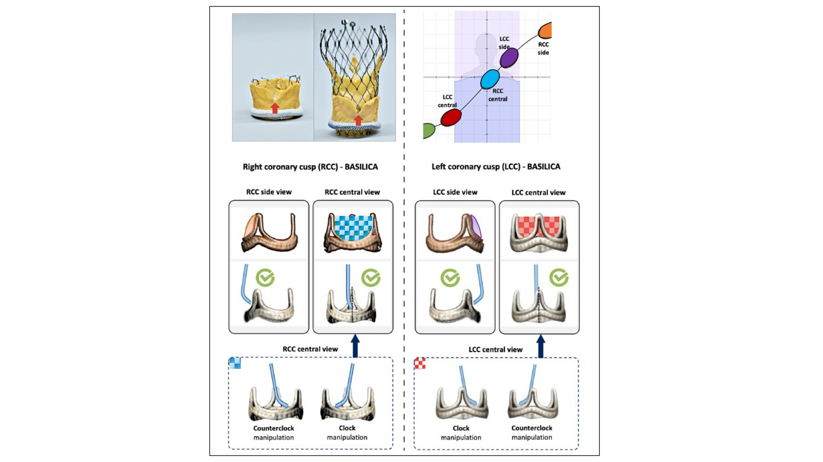

Fluoroscopic anatomy for the guidance of
transcatheter structural and coronary intervention (old)
Figure 29
Planning for BASILICA-assisted valve-in-valve transcatheter aortic valve replacement. Transcatheter electrosurgical aortic leaflet laceration (BASILICA [bioprosthetic or native aortic scallop intentional laceration to prevent iatrogenic coronary artery obstruction]) is an interventional technique to prevent coronary artery obstruction. An essential step in preprocedural planning for this procedure is determining the “side view” and “central view” of the leaflet to be lacerated; this can be achieved by understanding cusp and commissural orientation along the aortic annulus S-curve. The side view is used to assess the depth of the catheter in the target leaflet, the correct orientation of the catheter toward the leaflet, and wire traversal through the leaflet. The central view is used to guide catheter manipulation to achieve a position in the center of the leaflet. Partially reproduced with permission from Komatsu et al [31].
Horacio Medina de Chazal, Ali Zgheib, Angelo Quagliana, Michael Chetrit, Jean Buithieu, Giuseppe Martucci, Marco
Spaziano, Ali Abualsaud, Ole de Baker, Laurence Campens, Pascal Theriault-Lauzier, Jeremy Ben-Shoshan, Nicolo Piazza
©2025 Europa Group - All rights reserved.

