Slide 1


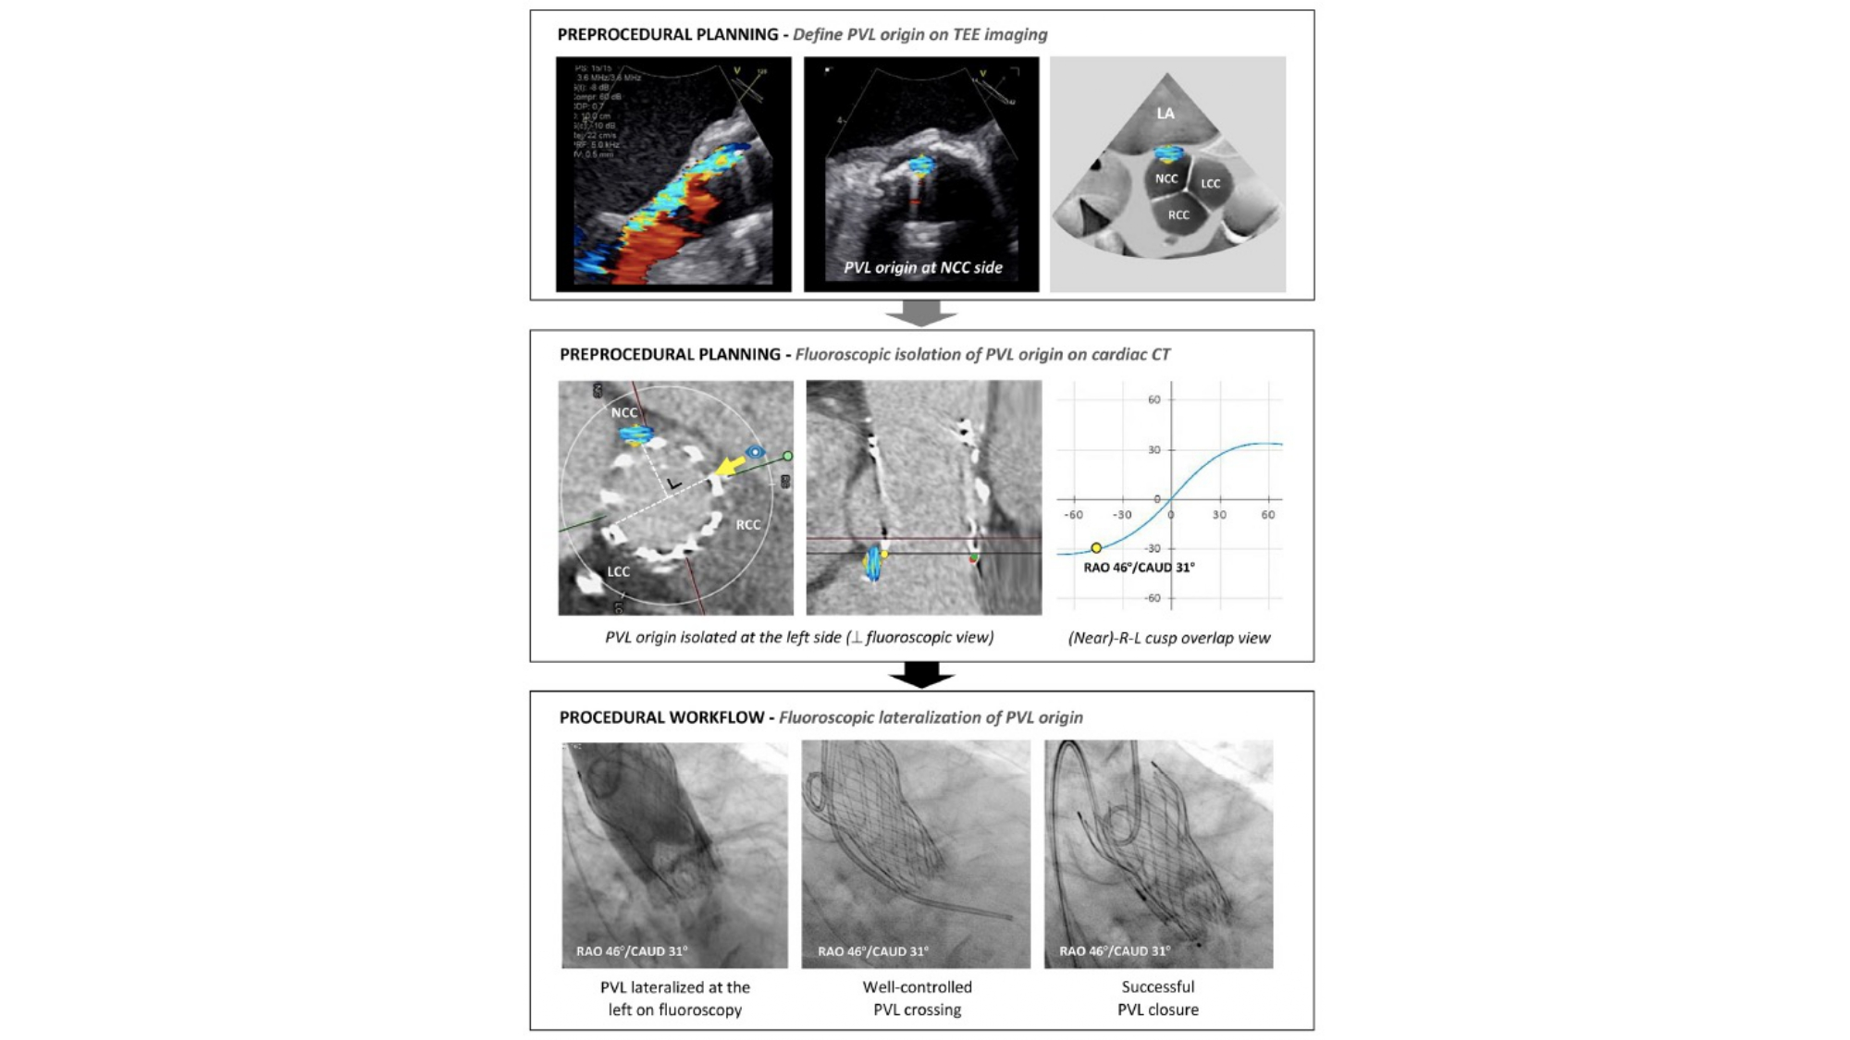

Fluoroscopic anatomy for the guidance of transcatheter structural and coronary intervention (old)
Figure 30
Optimal fluoroscopic view for PVL plugging. Following localization using transesophageal echocardiographic (TEE) imaging, the paravalvular leak (PVL) origin can be identified and labeled in the short-axis aortic annular plane viewed on cardiac computed tomography (CT). The optimal fluoroscopic projection for crossing and plugging can be determined by identifying a fluoroscopic view perpendicular to the PVL origin, thereby isolating (or lateralizing) the PVL origin. This figure illustrates an NCC-located PVL, which could be easily crossed and successfully closed using a fluoroscopic view perpendicular to the PVL origin (ie, a near R-L cusp overlap view, resulting in lateralization of the NCC) [12].
Horacio Medina de Chazal, Ali Zgheib, Angelo Quagliana, Michael Chetrit, Jean Buithieu, Giuseppe Martucci, Marco Spaziano, Ali Abualsaud, Ole de Baker, Laurence Campens, Pascal Theriault-Lauzier, Jeremy Ben-Shoshan, Nicolo Piazza
©2025 Europa Group - All rights reserved.

