Slide 1


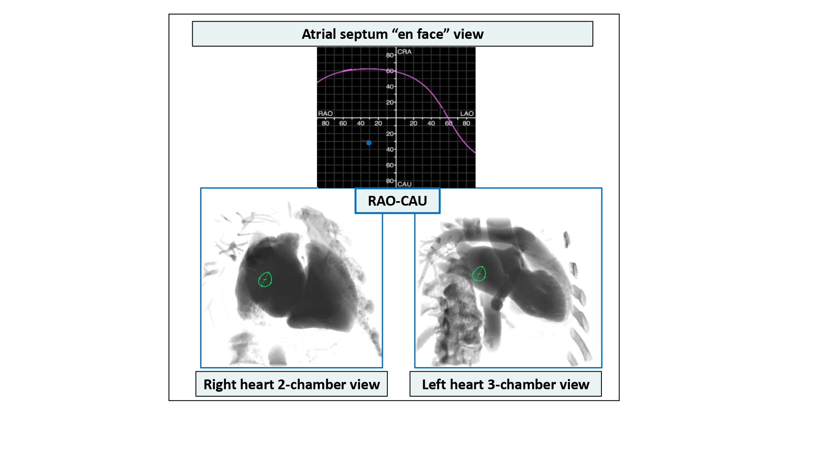

Fluoroscopic anatomy for the guidance of
transcatheter structural and coronary intervention (old)
Figure 32
Atrial septum en face view. Computed tomographic and fluoroscopic en-face view (blue dot) of the atrial septum can be appreciated in a RAO/CAU projection (i.e., right heart 2-chamber or left heart 3-chamber view.
Horacio Medina de Chazal, Ali Zgheib, Angelo Quagliana, Michael Chetrit, Jean Buithieu, Giuseppe Martucci, Marco
Spaziano, Ali Abualsaud, Ole de Baker, Laurence Campens, Pascal Theriault-Lauzier, Jeremy Ben-Shoshan, Nicolo Piazza
©2025 Europa Group - All rights reserved.

