Slide 1


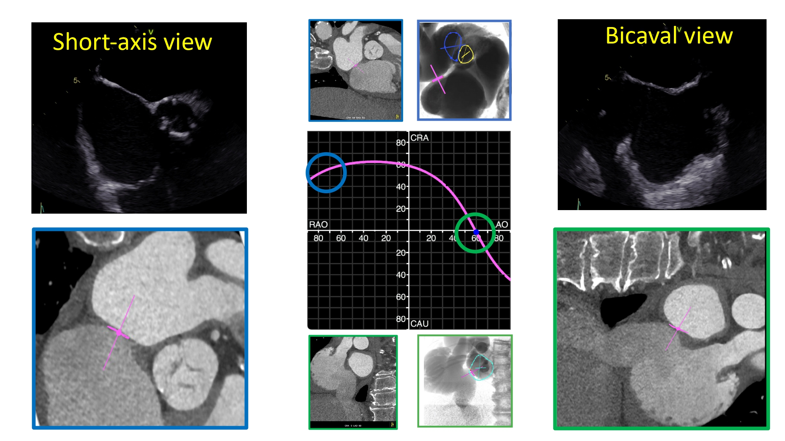

Fluoroscopic anatomy for the guidance of
transcatheter structural and coronary intervention (old)
Figure 36
Short-axis (blue) and bicaval (green) views of the AS in transesophageal echocardiography, MSCT and fluoroscopic view. S-curve of the AS depicting the angulations of the short-axis (blue circle) and bicaval (green circle) views.
Horacio Medina de Chazal, Ali Zgheib, Angelo Quagliana, Michael Chetrit, Jean Buithieu, Giuseppe Martucci, Marco
Spaziano, Ali Abualsaud, Ole de Baker, Laurence Campens, Pascal Theriault-Lauzier, Jeremy Ben-Shoshan, Nicolo Piazza
©2025 Europa Group - All rights reserved.

