Slide 1


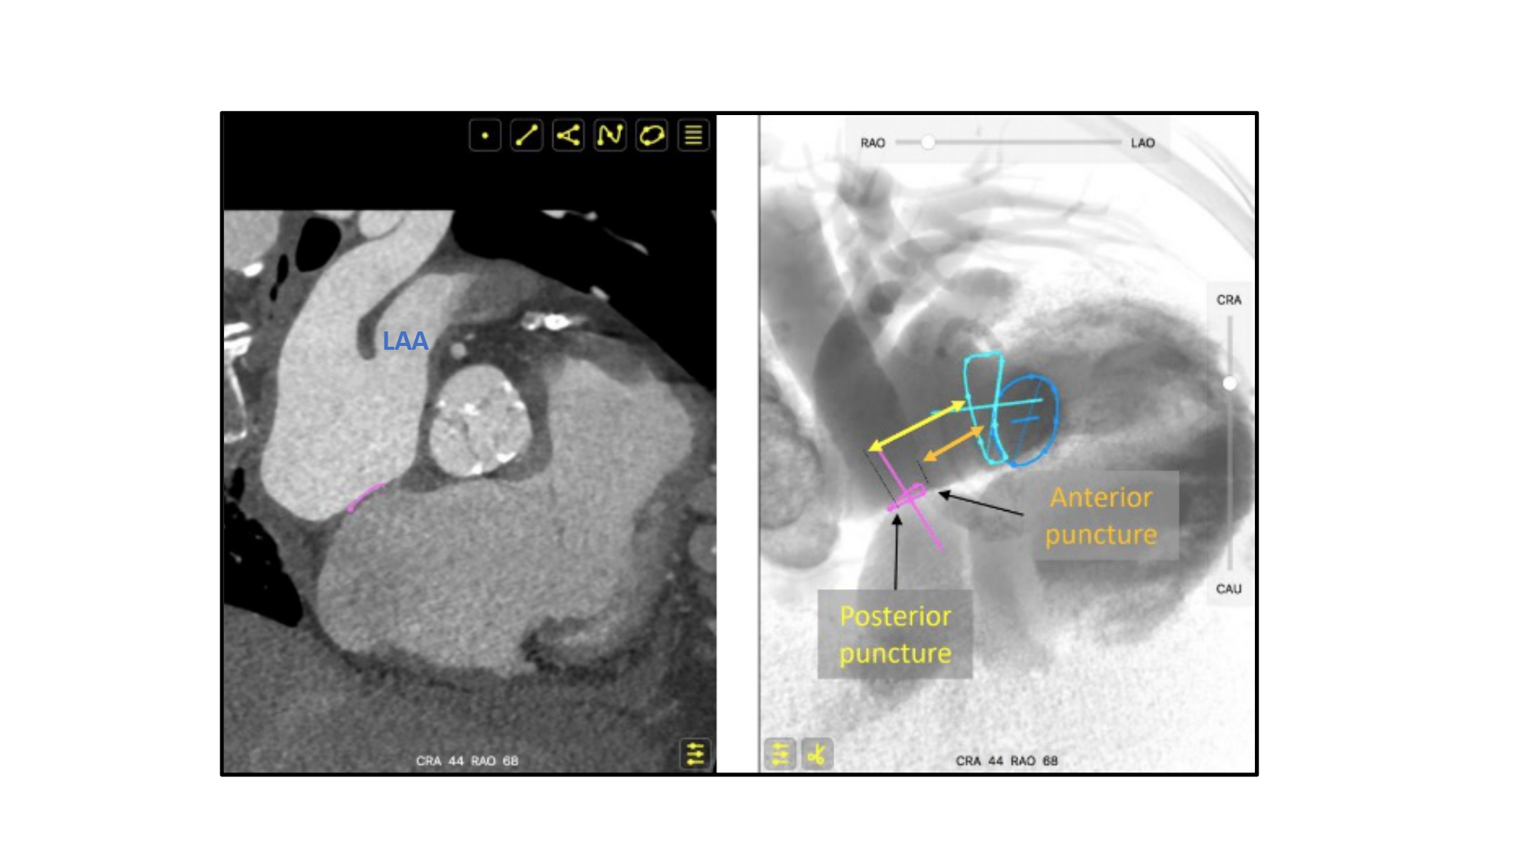

Fluoroscopic anatomy for the guidance of
transcatheter structural and coronary intervention (old)
Figure 37
Short axis view of the aortic valve during transeptal puncture for mitral procedures. Due to the orientation between the atrial septum (pink circle) and mitral valve (turquoise circle), a posterior puncture relative to the aortic valve, will result in a higher position relative to the mitral valve plane than an anterior puncture. LAA – left atrial appendage.
Horacio Medina de Chazal, Ali Zgheib, Angelo Quagliana, Michael Chetrit, Jean Buithieu, Giuseppe Martucci, Marco
Spaziano, Ali Abualsaud, Ole de Baker, Laurence Campens, Pascal Theriault-Lauzier, Jeremy Ben-Shoshan, Nicolo Piazza
©2025 Europa Group - All rights reserved.

