Slide 1


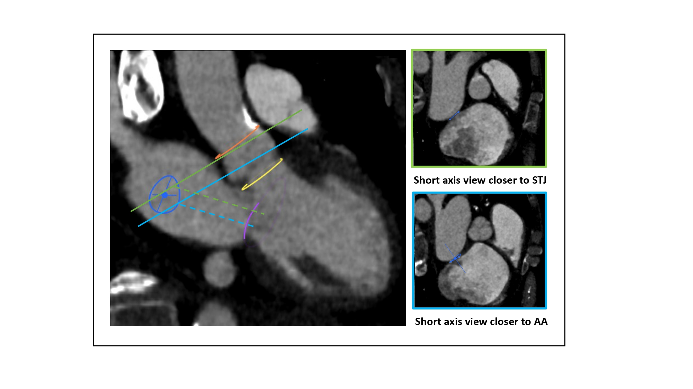

Fluoroscopic anatomy for the guidance of transcatheter structural and coronary intervention (old)
Figure 38
Relation between transseptal puncture height and location of the short axis view. 3-chamber view (MSCT) showing how the transseptal height above the mitral valve (purple circle) can be influenced by the location of the short-axis cut across the aortic root. The turquoise line represents a short-axis view closer to the base of the aortic annulus (yellow circle). The green line represents a short-axis view closer to the STJ (orange circle). A short axis view closer to the aortic annulus will translate into a shallower puncture (turquoise dotted line) than a puncture obtained with a short axis view at STJ level (green dotted line). STJ: sinotubular junction, AA: aortic annulus.
Horacio Medina de Chazal, Ali Zgheib, Angelo Quagliana, Michael Chetrit, Jean Buithieu, Giuseppe Martucci, Marco Spaziano, Ali Abualsaud, Ole de Baker, Laurence Campens, Pascal Theriault-Lauzier, Jeremy Ben-Shoshan, Nicolo Piazza
©2025 Europa Group - All rights reserved.

