Slide 1


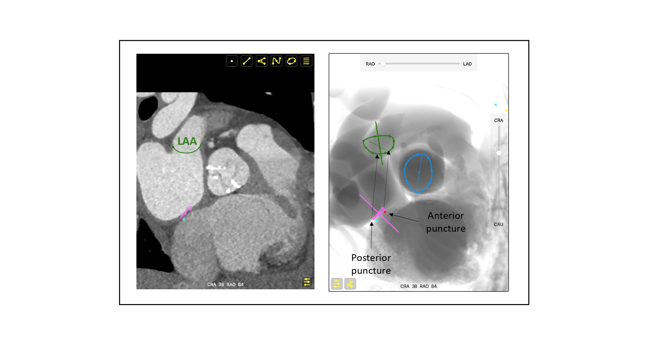

Fluoroscopic anatomy for the guidance of transcatheter structural and coronary intervention (old)
Figure 39
Transseptal puncture for left atrial appendage (LAA) closure. Due to the orientation between the atrial septum and LAA orifice (the LAA is anterior to the atrial septum), a posterior puncture relative to the aortic valve will provide a more coaxial and central orientation towards the LAA orifice. Pink circle (atrial septum), green circle (LAA orifice), red dot (anterior puncture), turquoise dot (posterior puncture).
Horacio Medina de Chazal, Ali Zgheib, Angelo Quagliana, Michael Chetrit, Jean Buithieu, Giuseppe Martucci, Marco Spaziano, Ali Abualsaud, Ole de Baker, Laurence Campens, Pascal Theriault-Lauzier, Jeremy Ben-Shoshan, Nicolo Piazza
©2025 Europa Group - All rights reserved.

