Slide 1


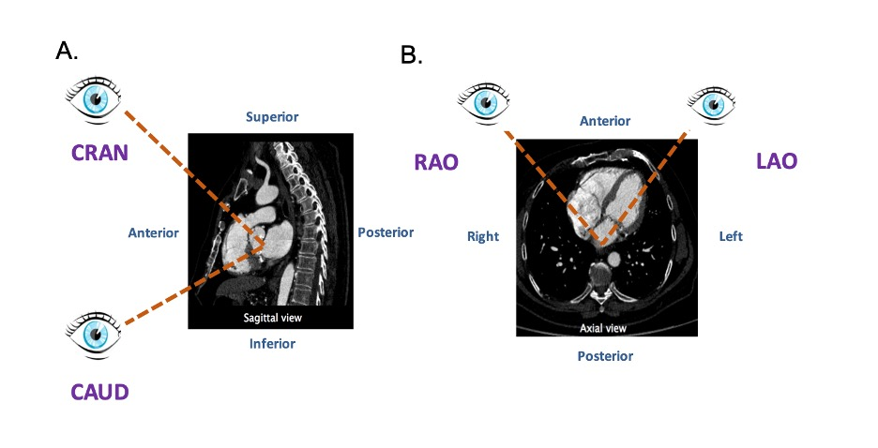

Fluoroscopic anatomy for the guidance of
transcatheter structural and coronary intervention (old)
Figure 4
Attitudinal viewing of MSCT image simulating the C-arm rotation around a lying patient in the catheterization laboratory. (A) Sagittal view: from an anterior position structure closer to the head are labelled as cranial (CRA) and those closer to the feet are labelled as caudal (CAU). (B) Axial view: from an anterior position structure closer to the right of the patients are labelled as right anterior oblique (RAO) and those closer to the left are labelled as left anterior oblique (LAO).
Horacio Medina de Chazal, Ali Zgheib, Angelo Quagliana, Michael Chetrit, Jean Buithieu, Giuseppe Martucci, Marco
Spaziano, Ali Abualsaud, Ole de Baker, Laurence Campens, Pascal Theriault-Lauzier, Jeremy Ben-Shoshan, Nicolo Piazza
©2025 Europa Group - All rights reserved.

