Slide 1


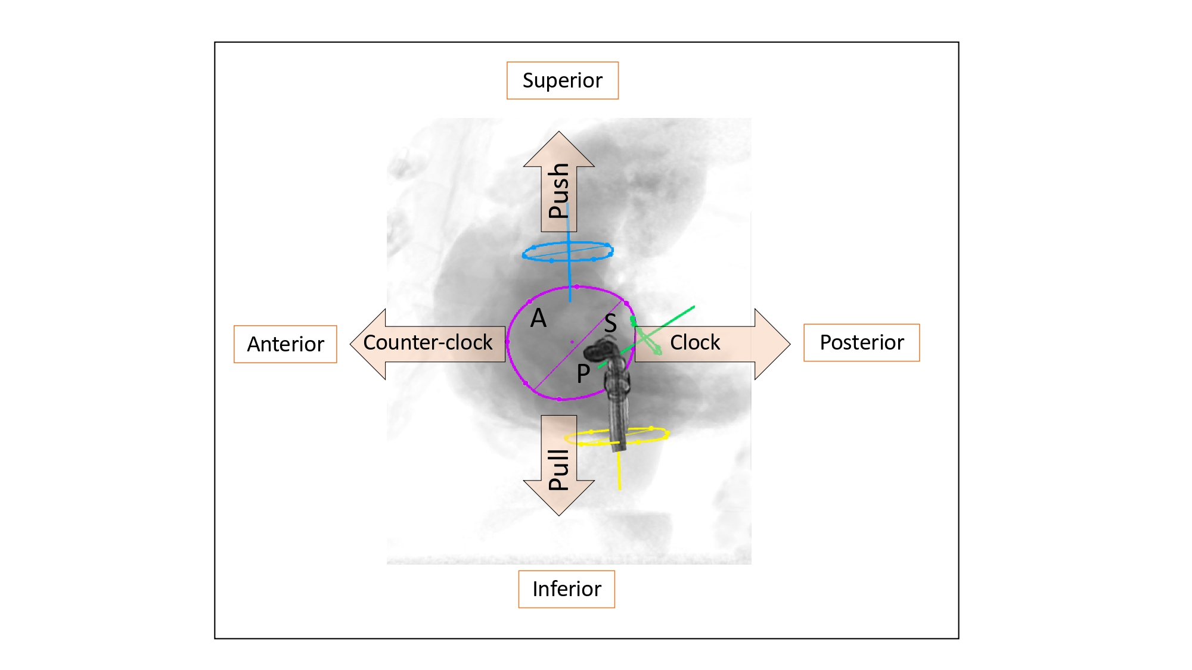

Fluoroscopic anatomy for the guidance of transcatheter structural and coronary intervention (old)
Figure 41
Fluoroscopic bicaval view for transcatheter procedures. Clip delivery system is simulated for transcatheter tricuspid valve edge-to-edge repair. The fluoroscopic bicaval view provides a wealth of information about catheter manipulations in the superior (pushing toward the atrial septum [green circle]), inferior (pulling toward posteroseptal commissure, anterior (counter clockwise rotation) and posterior (clockwise rotation) directions required during transcatheter tricuspid interventions for transcatheter mitral valve interventions. Circles represent: turquoise: superior vena cava, yellow: inferior vena cava, green: atrial septum, violet: tricuspid valve.
Horacio Medina de Chazal, Ali Zgheib, Angelo Quagliana, Michael Chetrit, Jean Buithieu, Giuseppe Martucci, Marco Spaziano, Ali Abualsaud, Ole de Baker, Laurence Campens, Pascal Theriault-Lauzier, Jeremy Ben-Shoshan, Nicolo Piazza
©2025 Europa Group - All rights reserved.

