Slide 1


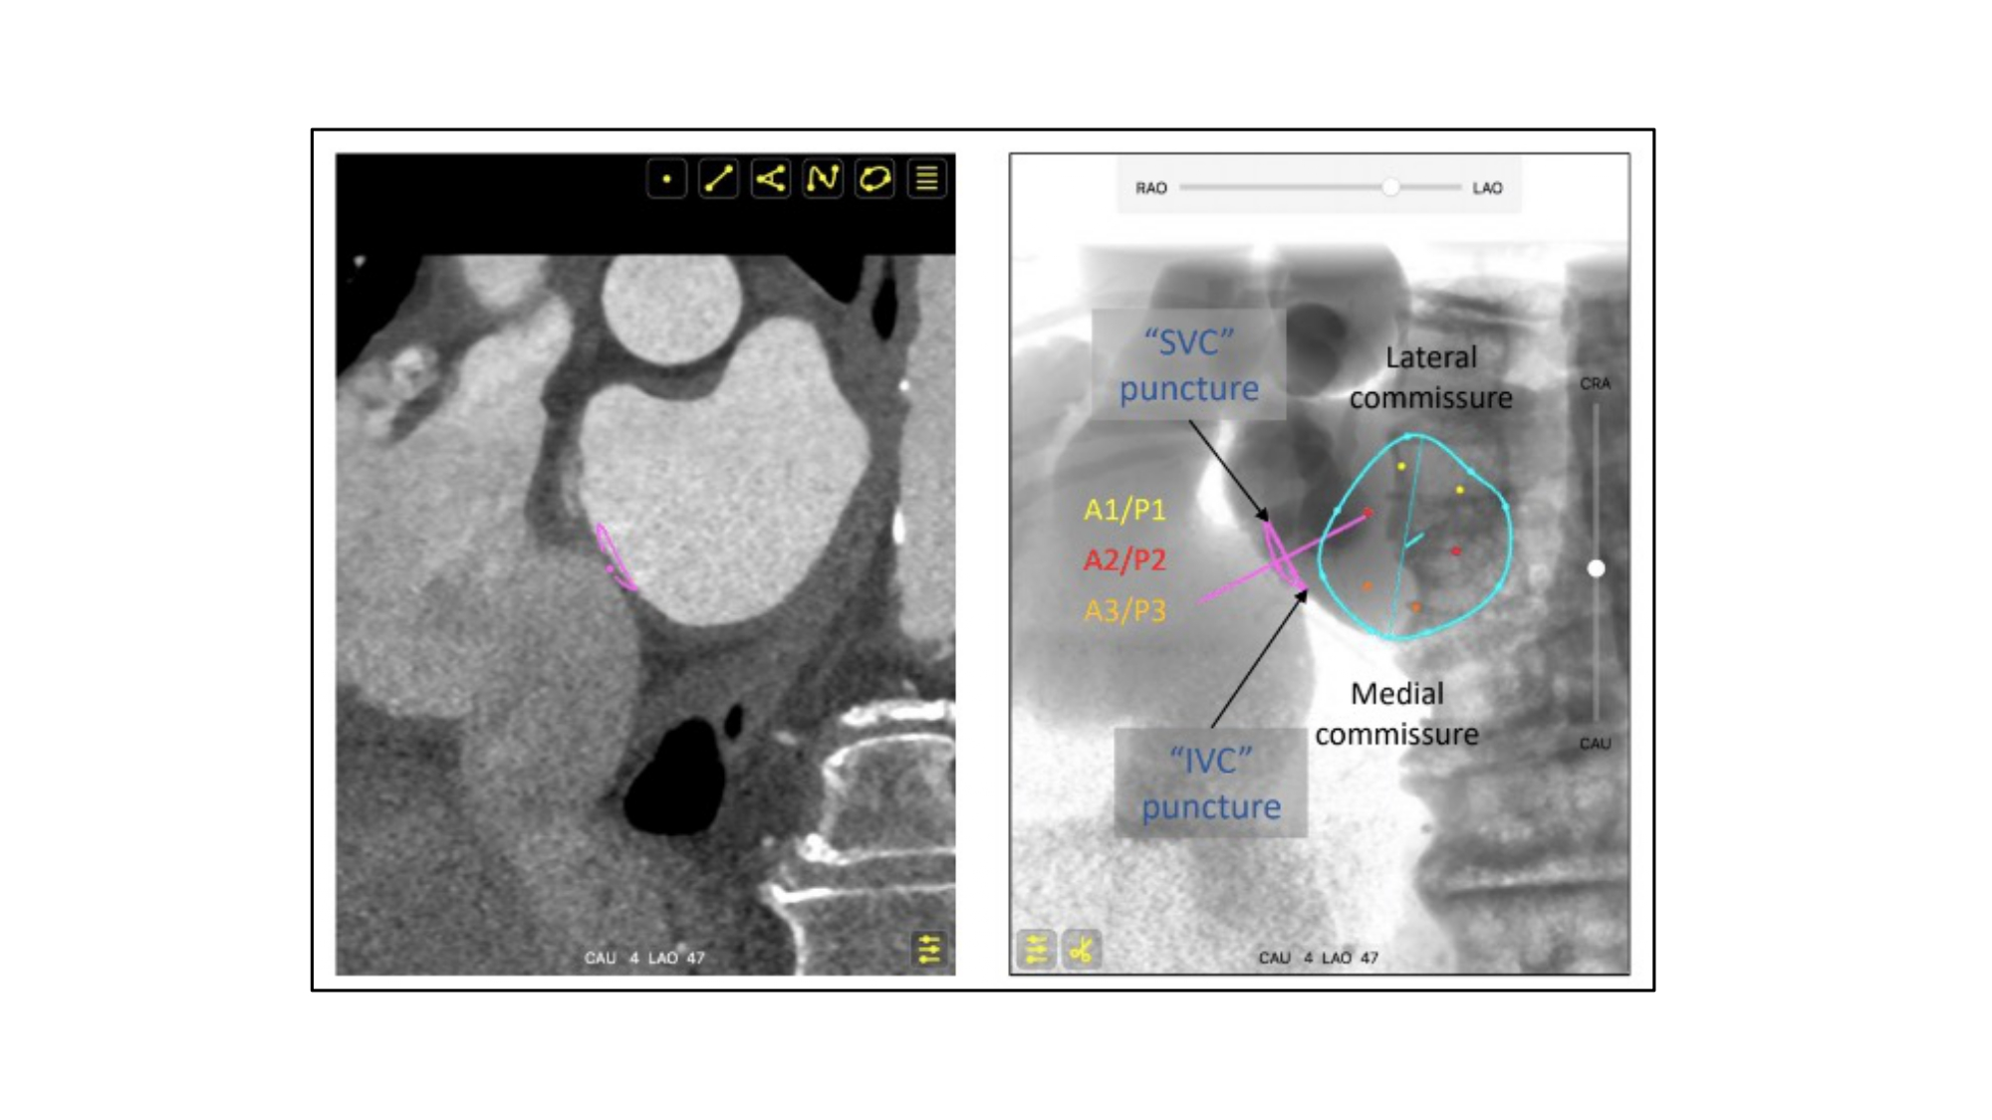

Fluoroscopic anatomy for the guidance of
transcatheter structural and coronary intervention (old)
Figure 42
MSCT and fluoroscopic bicaval view relative to mitral valve. The simulated fluoroscopic bicaval view highlights the relative superior and inferior locations of the lateral and medial commissures of the mitral valve relative to the atrial septal plane. An extension of this describes the superior to inferior layout of the A1-P1 (yellow dots), A2-P2 (red dots), and A3-P3 (orange dots) segments of the mitral valve. Pink circle represents the atrial septum, turquoise circle represents the mitral valve. MSCT: multislice computed tomography.
Horacio Medina de Chazal, Ali Zgheib, Angelo Quagliana, Michael Chetrit, Jean Buithieu, Giuseppe Martucci, Marco
Spaziano, Ali Abualsaud, Ole de Baker, Laurence Campens, Pascal Theriault-Lauzier, Jeremy Ben-Shoshan, Nicolo Piazza
©2025 Europa Group - All rights reserved.

