Slide 1


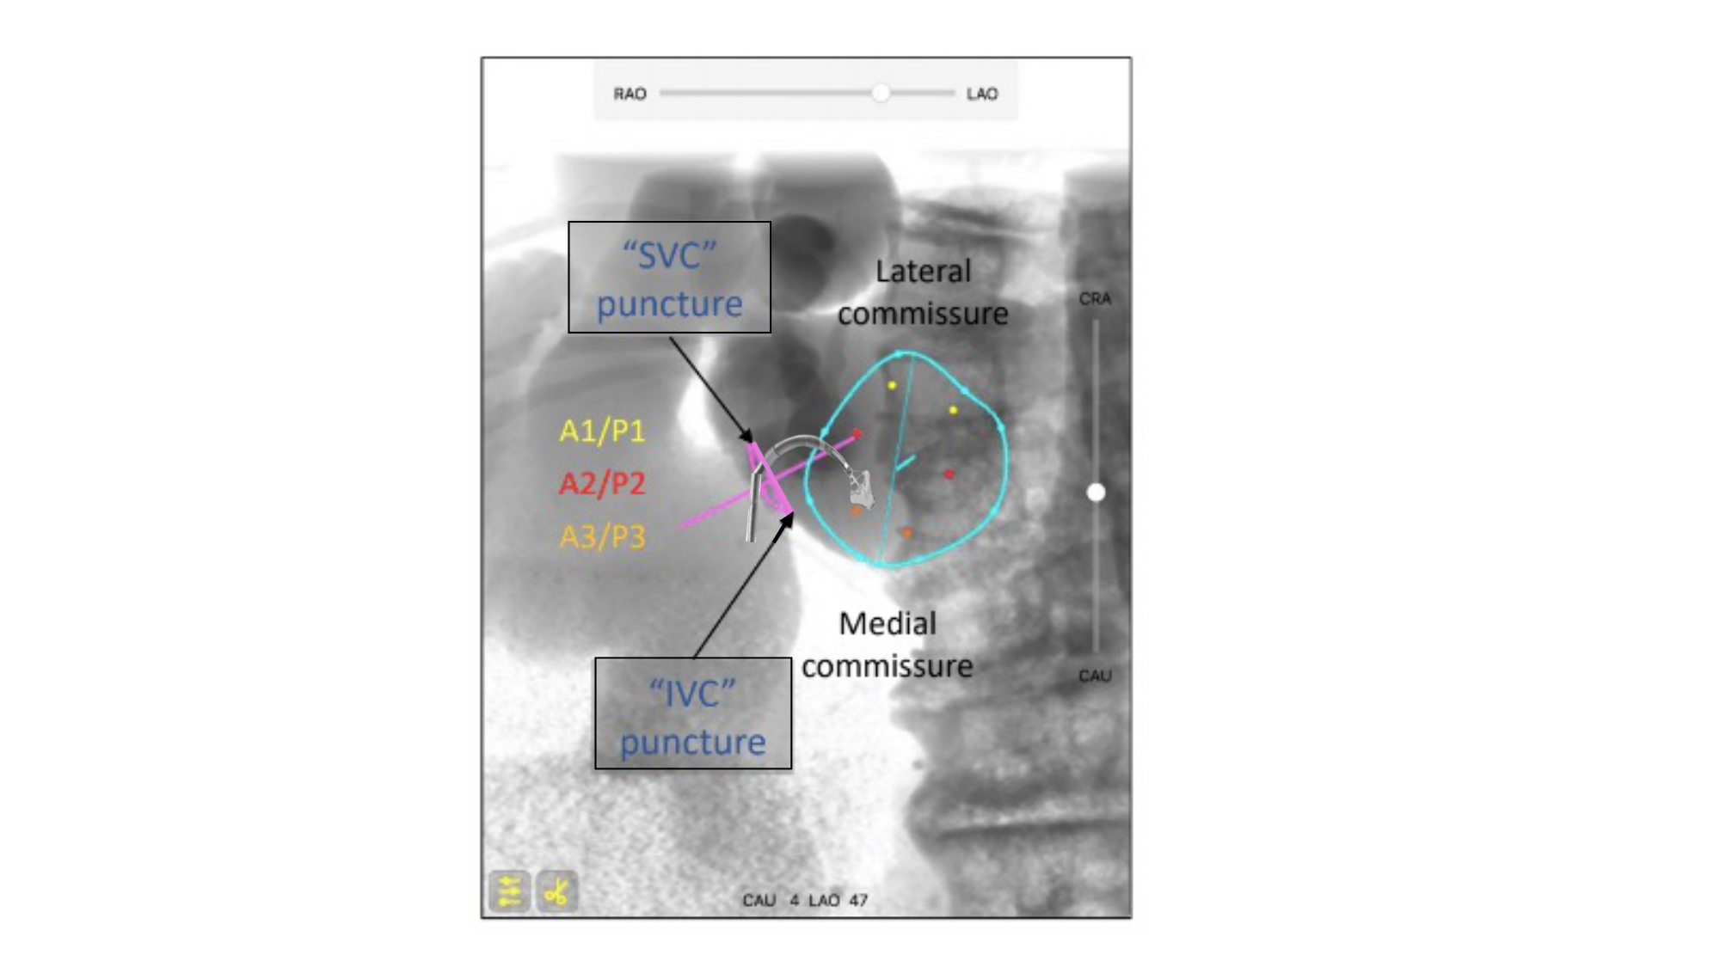

Fluoroscopic anatomy for the guidance of transcatheter structural and coronary intervention (old)
Figure 43
Relation between infero-superior aspect of transeptal puncture and mitral valve commissures. An example of superior transeptal puncture for transcatheter mitral edge-to-edge repair is provided. The simulated fluoroscopic bicaval view highlights the relative superior and inferior locations of the lateral and medial commissures of the mitral valve relative to the atrial septal plane. A puncture closer to the superior vena cava will translate into a closer catheter position to the right trigone/A2 which facilitates catheter manipulation over the mitral valve. A puncture closer to the inferior vena cava will translate into a closer catheter position to the medial commissure which facilitates catheter direction towards the lateral commissure but may hinder catheter manipulation over the mitral valve.
Horacio Medina de Chazal, Ali Zgheib, Angelo Quagliana, Michael Chetrit, Jean Buithieu, Giuseppe Martucci, Marco Spaziano, Ali Abualsaud, Ole de Baker, Laurence Campens, Pascal Theriault-Lauzier, Jeremy Ben-Shoshan, Nicolo Piazza
©2025 Europa Group - All rights reserved.

