Slide 1


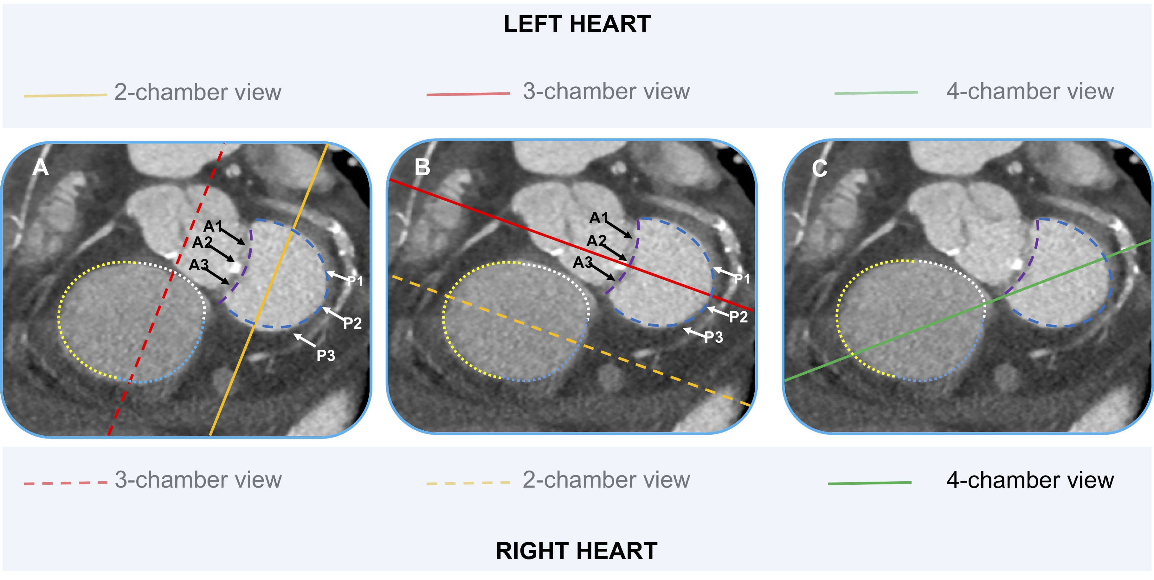

Fluoroscopic anatomy for the guidance of
transcatheter structural and coronary intervention (old)
Figure 44
Fluoroscopic standardized views of the mitral and tricuspid valves. The one-chamber (short-axis) view (blue panels) show the en-face view of the mitral and tricuspid annulus seen by the ventricular side. The attachment of the anterior mitral leaflet (dashed purple lines) and posterior leaflet (dashed blue lines) are reported in each panel. The black arrows correspond to the scallops (A1, A2, A3) of the anterior mitral leaflet. The black arrows correspond to the scallops (P1, P2, P3) of the posterior mitral leaflet. The attachments of the anterior (black dotted line), posterior (green dotted line) and septal (orange dotted line) are reported in each panel. The continuous lines corresponding to the different chamber views. (A) The continue yellow line represents the plane of the 2-chamber view for the left side of the heart, which corresponds to the 3-chamber view for the right side of the heart (dashed red line); (B) The continue red line represents the plane of the 3-chamber view for the left side of the heart, which corresponds to the 2-chamber view for the right side of the heart (dashed yellow line); (C) The continue green line represents the plane of the 4-chamber view, which is identical for both the left and the right side of the heart. A = anterior; P = posterior; Ao = aortic valve; MV = mitral valve; TV = tricuspid valve.
Horacio Medina de Chazal, Ali Zgheib, Angelo Quagliana, Michael Chetrit, Jean Buithieu, Giuseppe Martucci, Marco
Spaziano, Ali Abualsaud, Ole de Baker, Laurence Campens, Pascal Theriault-Lauzier, Jeremy Ben-Shoshan, Nicolo Piazza
©2025 Europa Group - All rights reserved.

