Slide 1


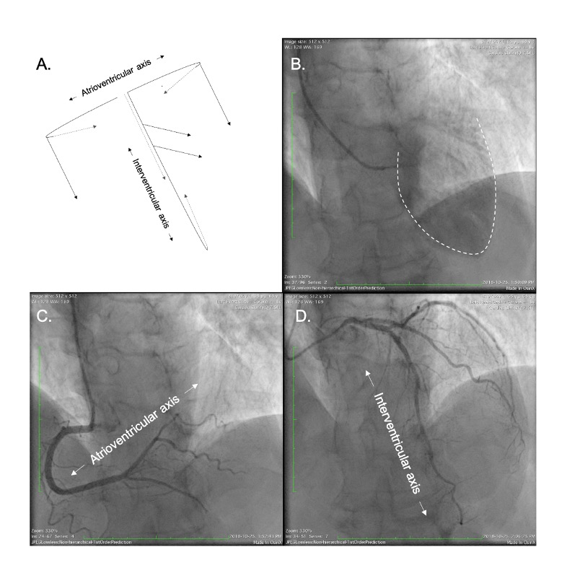

Fluoroscopic anatomy for the guidance of transcatheter structural and coronary intervention (old)
Figure 45
Cardiac short and long axes in a four-chamber view (LAO/CRA) during coronary angiography. The coronary tree sprawls on an atrioventricular/short-axis, extending rightward and inferiorly, and an interventricular/long-axis, extending leftward and inferiorly (A). Left ventricle angiogram in a four-chamber view shows the anterolateral, apical and anteroseptal walls of the left ventricle (B). The RCA circumvents the tricuspid valve along the atrioventricular axis (C). The LAD artery runs leftward and inferiorly toward the apex along the interventricular cardiac axis (D).
Horacio Medina de Chazal, Ali Zgheib, Angelo Quagliana, Michael Chetrit, Jean Buithieu, Giuseppe Martucci, Marco Spaziano, Ali Abualsaud, Ole de Baker, Laurence Campens, Pascal Theriault-Lauzier, Jeremy Ben-Shoshan, Nicolo Piazza
©2025 Europa Group - All rights reserved.

