Slide 1


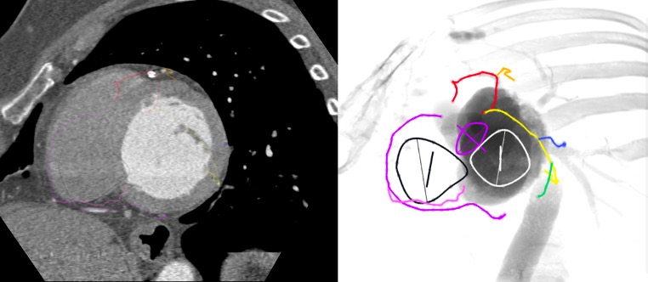

Fluoroscopic anatomy for the guidance of transcatheter structural and coronary intervention (old)
Figure 46
Coronary anatomy from a fluoroscopic one chamber view of the left heart (LAO/CAU). In this view the RCA (purple) and circumflex (yellow) are seen elongated in its course along atrioventricular groove. The posterior descending artery is foreshortened. The LAD (red) is foreshortened within the interventricular groove.
Horacio Medina de Chazal, Ali Zgheib, Angelo Quagliana, Michael Chetrit, Jean Buithieu, Giuseppe Martucci, Marco Spaziano, Ali Abualsaud, Ole de Baker, Laurence Campens, Pascal Theriault-Lauzier, Jeremy Ben-Shoshan, Nicolo Piazza
©2025 Europa Group - All rights reserved.

