Slide 1


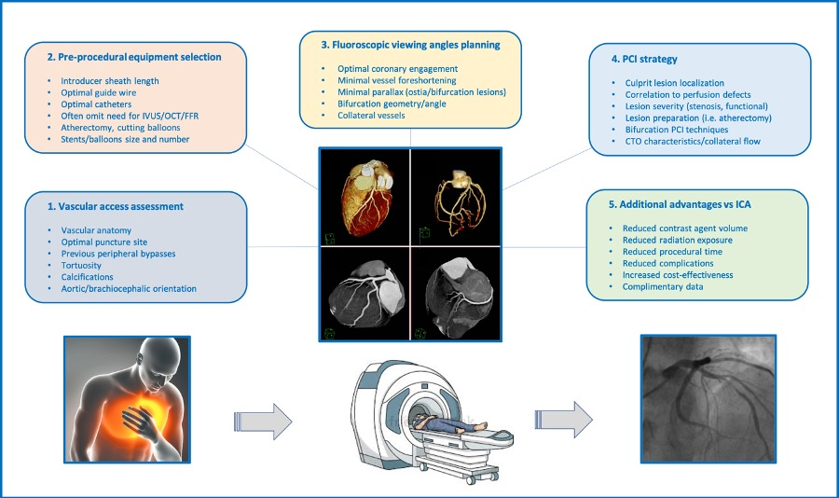

Fluoroscopic anatomy for the guidance of transcatheter structural and coronary intervention (old)
Figure 49
The multiple potential roles of CCTA in planning of coronary interventions. CCTA allow for optimal selection of vascular access, equipment selection, fluoroscopic viewing angles, PCI strategy, while reducing contrast agent volume, radiation exposure and PCI-associated technical errors and potential sequelae. CCTA: coronary computed tomography angiography.
Horacio Medina de Chazal, Ali Zgheib, Angelo Quagliana, Michael Chetrit, Jean Buithieu, Giuseppe Martucci, Marco Spaziano, Ali Abualsaud, Ole de Baker, Laurence Campens, Pascal Theriault-Lauzier, Jeremy Ben-Shoshan, Nicolo Piazza
©2025 Europa Group - All rights reserved.

