Slide 1


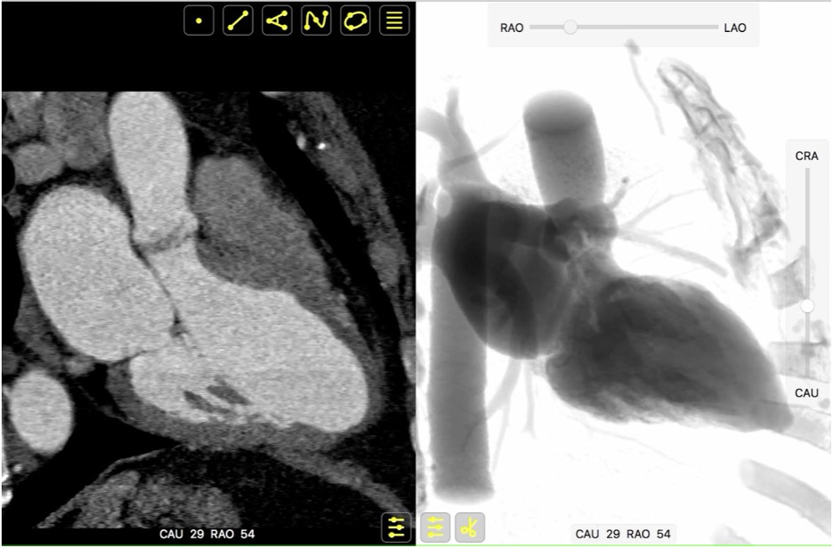

Fluoroscopic anatomy for the guidance of
transcatheter structural and coronary intervention (old)
Figure 5
Integration of multimodality imaging data. Both MSCT and fluoroscopy hinge on the same image contrast mechanism, X-ray attenuation. It is thus possible to apply MSCT volumetric data to simulate fluoroscopic images, using a ray-casting method. This feature permits parallel registration and rotation of MSCT and fluoroscopy images using a virtual C-arm analogous to that used in the catheterization laboratory.
Horacio Medina de Chazal, Ali Zgheib, Angelo Quagliana, Michael Chetrit, Jean Buithieu, Giuseppe Martucci, Marco
Spaziano, Ali Abualsaud, Ole de Baker, Laurence Campens, Pascal Theriault-Lauzier, Jeremy Ben-Shoshan, Nicolo Piazza
©2025 Europa Group - All rights reserved.

