Slide 1


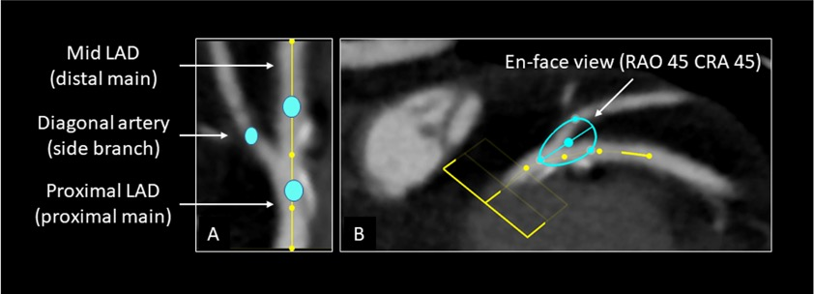

Fluoroscopic anatomy for the guidance of transcatheter structural and coronary intervention (old)
Figure 51
Analysis of optimal fluoroscopic viewing angles of bifurcating coronary arteries. A centerline is created in the LAD artery at least 5 mm proximally and distally from the diagonal branch take-off. Curved multiplanar reconstruction is used to create a center line and identify the bifurcation (inlet). The plane or en-face view of the bifurcation is created by placing 3 dots in the proximal main vessel, distal main vessel, and diagonal branch at 5 mm distance from the polygon of confluence. The en-face view of the plane provides the optimal fluoroscopic projection for analyzing bifurcation lesions.
Horacio Medina de Chazal, Ali Zgheib, Angelo Quagliana, Michael Chetrit, Jean Buithieu, Giuseppe Martucci, Marco Spaziano, Ali Abualsaud, Ole de Baker, Laurence Campens, Pascal Theriault-Lauzier, Jeremy Ben-Shoshan, Nicolo Piazza
©2025 Europa Group - All rights reserved.

