Slide 1


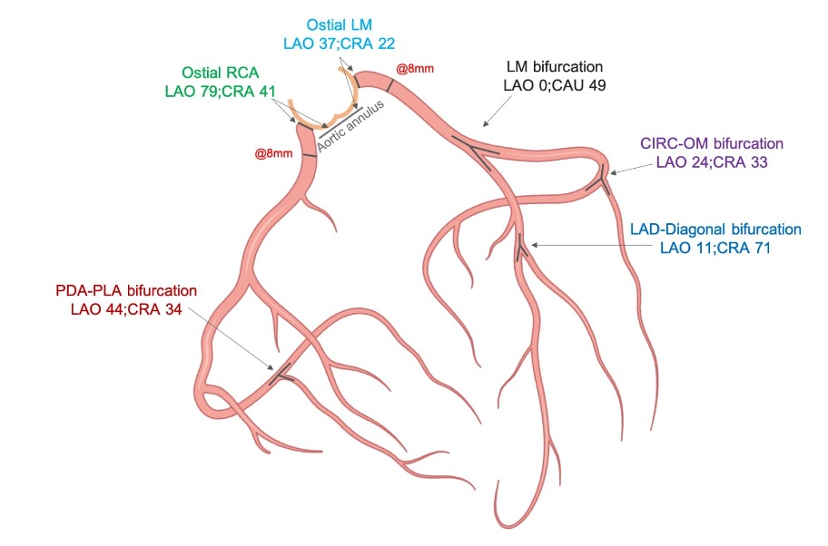

Fluoroscopic anatomy for the guidance of transcatheter structural and coronary intervention (old)
Figure 52
Optimal fluoroscopic projections of coronary ostia and bifurcations defined by CCTA. Shown are optimal viewing angles for PCI of the right and left coronary ostia, as well as coronary bifurcations based on a retrospective analysis of 100 consecutive patients who underwent CTCA for suspected CAD.
Horacio Medina de Chazal, Ali Zgheib, Angelo Quagliana, Michael Chetrit, Jean Buithieu, Giuseppe Martucci, Marco Spaziano, Ali Abualsaud, Ole de Baker, Laurence Campens, Pascal Theriault-Lauzier, Jeremy Ben-Shoshan, Nicolo Piazza
©2025 Europa Group - All rights reserved.

