Slide 1


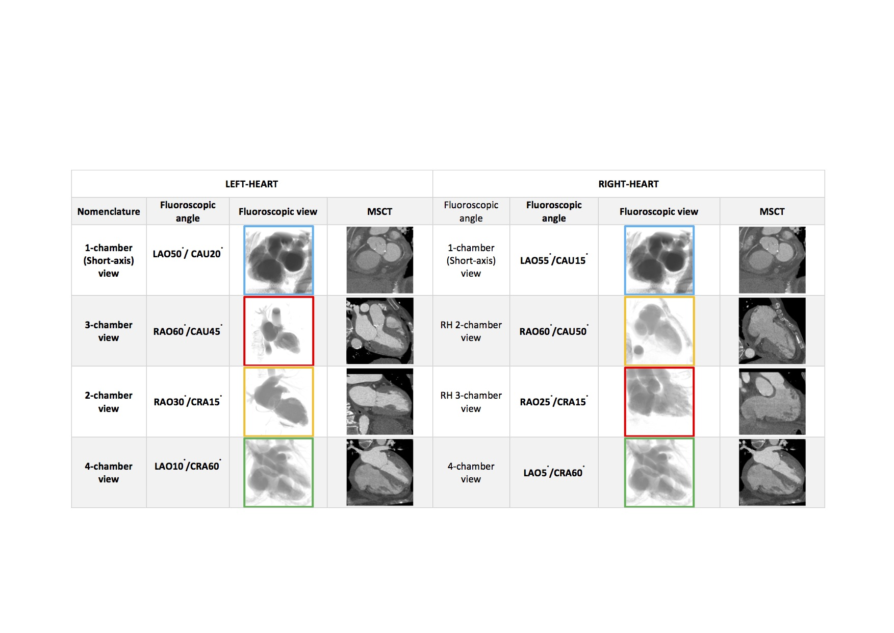

Fluoroscopic anatomy for the guidance of transcatheter structural and coronary intervention (old)
Figure 6
Fluoroscopic chamber views and corresponding multislice computed tomography imaging of the left- and right heart. Throughout the chapter, chamber views are color-coded: 1-chamber (blue); 2-chamber (yellow); 3-chamber (red); 4-chamber (green), when not stated otherwise. Abbreviations: CAU = caudal; CRA = cranial; LAO = left anterior oblique; MSCT = multislice computed tomography; RH = right heart.
Horacio Medina de Chazal, Ali Zgheib, Angelo Quagliana, Michael Chetrit, Jean Buithieu, Giuseppe Martucci, Marco Spaziano, Ali Abualsaud, Ole de Baker, Laurence Campens, Pascal Theriault-Lauzier, Jeremy Ben-Shoshan, Nicolo Piazza
©2025 Europa Group - All rights reserved.

