Slide 1


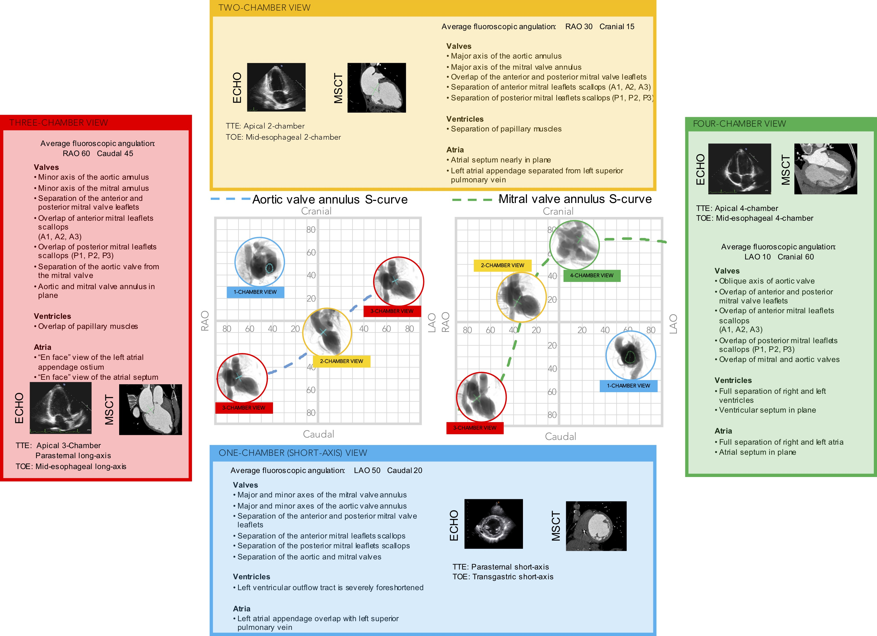

Fluoroscopic anatomy for the guidance of transcatheter structural and coronary intervention (old)
Figure 9
Multimodality imaging of the left side of the heart, aortic and mitral valve. The optimal projection curves of the aortic and mitral annulus are plotted as a blue dotted line (aortic valve annulus) and green dotted line (mitral valve annulus). The region of fluoroscopic angulations corresponding to each of the chamber views is indicated by circles. The panels correspond to the two-chamber (yellow), three- chamber (red) and the four-chamber (green) views. Each panel presents the matching echocardiographic and MSCT images corresponding to the fluoroscopic view of interest (circles). LAO: left anterior oblique; MSCT: multislice computed tomography; RAO: right anterior oblique; TOE: transoesophageal echocardiography; TTE: transthoracic echocardiography.
Horacio Medina de Chazal, Ali Zgheib, Angelo Quagliana, Michael Chetrit, Jean Buithieu, Giuseppe Martucci, Marco Spaziano, Ali Abualsaud, Ole de Baker, Laurence Campens, Pascal Theriault-Lauzier, Jeremy Ben-Shoshan, Nicolo Piazza
©2025 Europa Group - All rights reserved.

